Slide 1


Laboratory of Quantitative Forest Ecosystem Science
q-forestlab.ugent.be

Slide 2




Co-registration of RIEGL VZ-400 data
RiSCAN PRO manual
Laser scanning group

Slide 3
RiSCAN PRO
Within this manual we will use the RiSCAN PRO software to process (co-register) TLS data collected with a RIEGL VZ-400 scanner. If you have not yet installed the RiSCAN PRO software check the RiSCAN_PRO_inprogress manual on Teams.
This manual works best after reading it through and receiving a demo of this process on one of the computers at the office and then using it to independently process your data. Contact Louise.Terryn@UGent.be for more info.
This manual is for the VZ-400 scanner (not the VZ-400i scanner, which has upgraded hard -and software, requiring a different approach for co-registration).

Slide 4
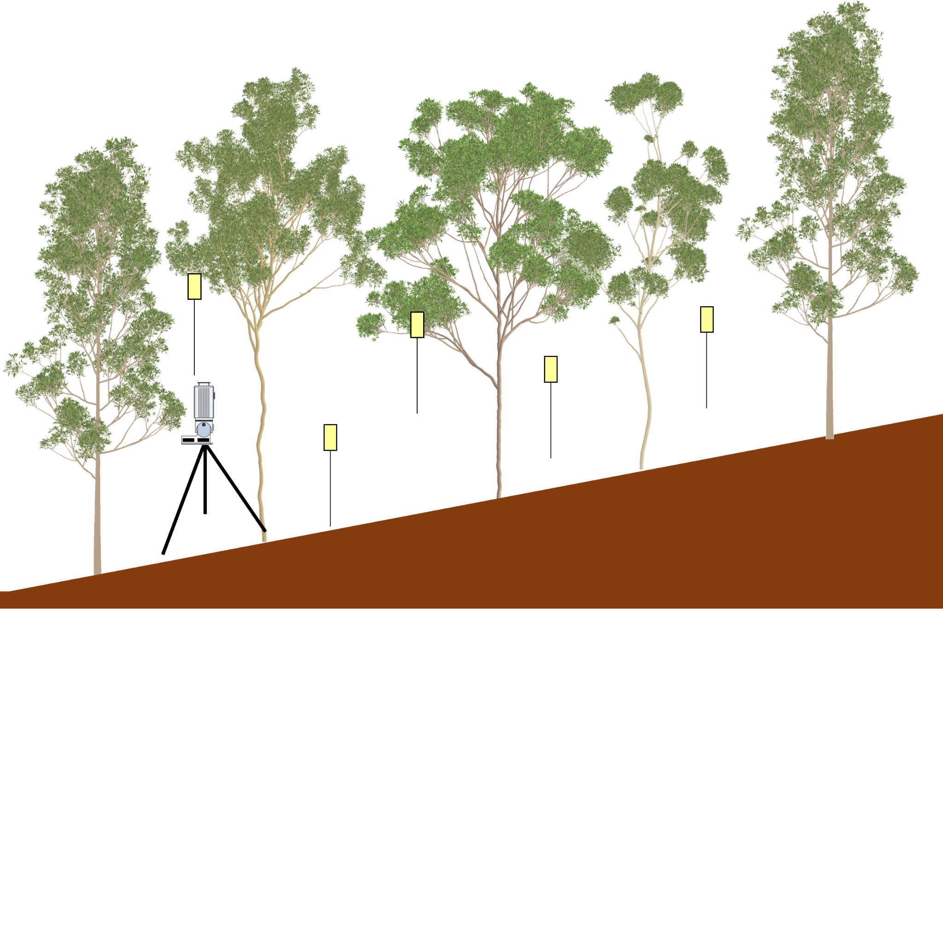
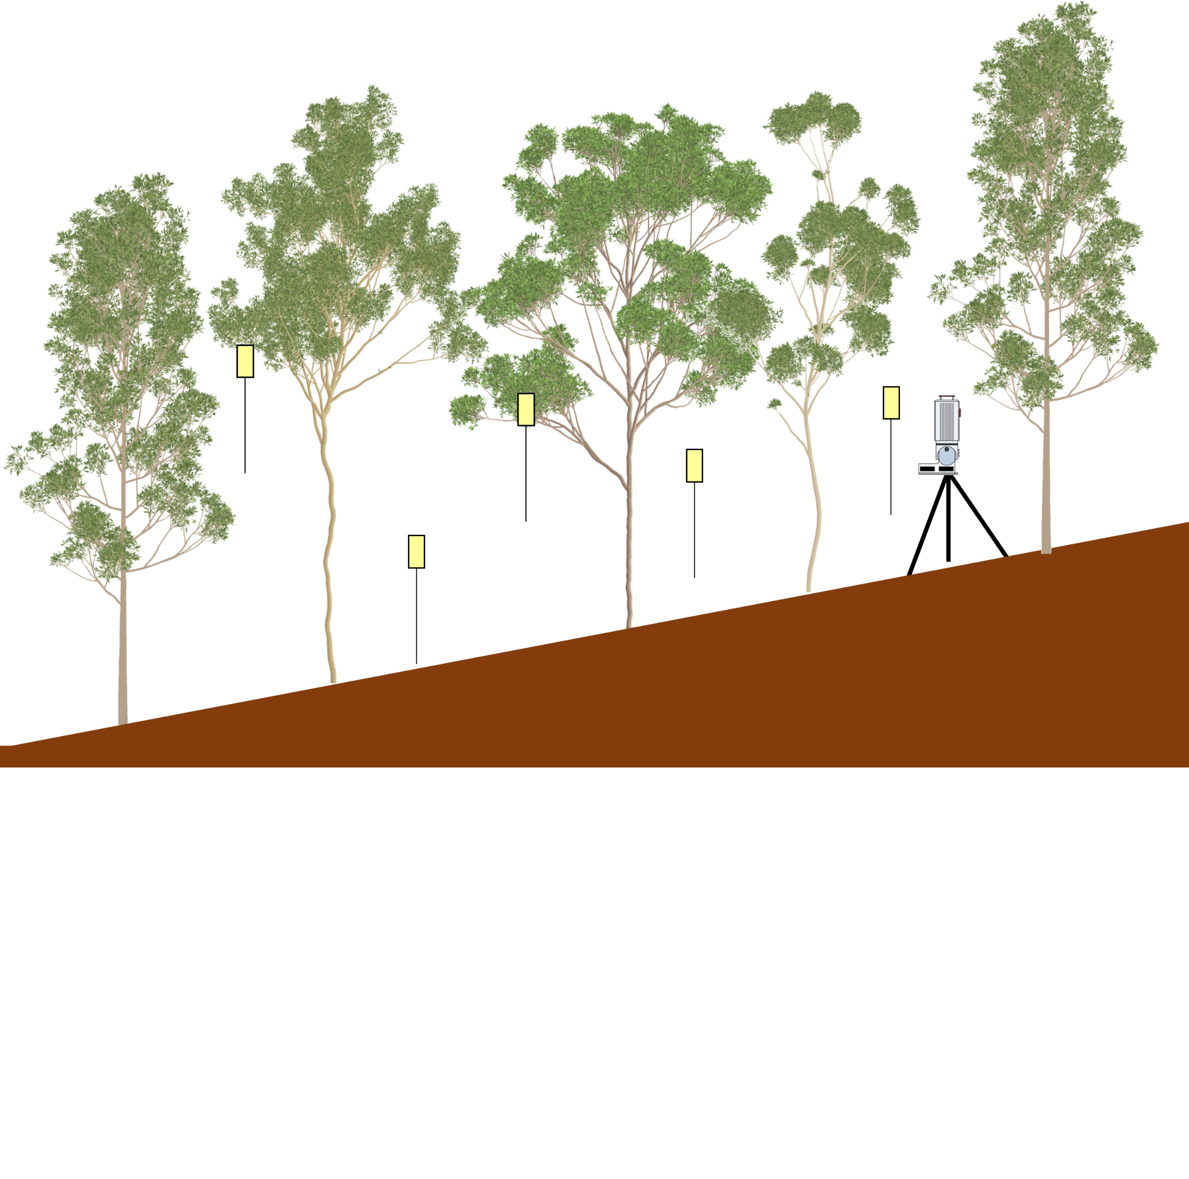
Co-registration
When collecting TLS data of a forest plot, we collect scans at multiple scan locations/positions to be able to capture the complete forest structure. This results in multiple separate scans/point clouds collected at different locations in the forest, each in their own coordinate system.
Scan location 2
Scan location 1

Slide 5
Co-registration
However, we want these scans in the same coordinate system (for further processing). Aligning the scans so we can achieve this is what we call co-registration. When using the VZ-400 scanner, reflectors are put in the field during scanning to facilitate this.
Reflector

Slide 6
Co-registration
However, we want these scans in the same coordinate system (for further processing). Aligning the scans so we can achieve this is what we call co-registration. When using the VZ-400 scanner, reflectors are put in the field during scanning to facilitate this.

Slide 7
Co-registration
The co-registration consists of two main parts:
The coarse co-registration where the reflectors (that were put in the field) are used to roughly align the scans. Often an error of a few centimeters remains on this alignment.
The fine co-registration where that alignment is improved. For the fine/accurate co-registration of the different scan positions, an algorithm (Multi Station Adjustment – MSA*) will be used. This algorithm relies on matching plane patches derived from the various scans.
*This is different from the “Multi Station Adjustment 2” algorithm which only works for VZ i-series scanners.

Slide 8

PREPARATION
IMPORT & CONVERT
CLEAN & FILTER
FIND REFLECTORS
MAKE PLANE PATCHES
COARSE CO-REGISTRATION (TIE POINTS)
FINE CO-REGISTRATION (MSA1)
SAVE & COMBINE
STEPS

Slide 9
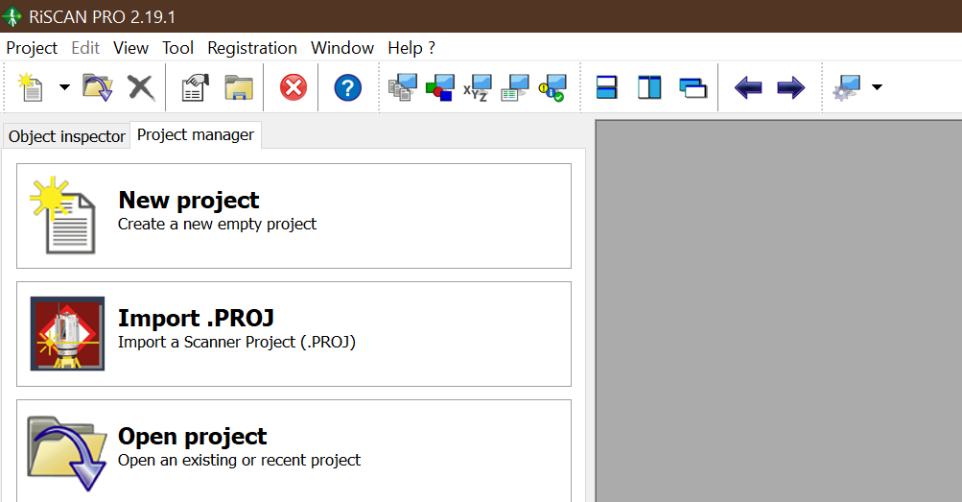
Preparation
Copy the raw data (*.riproject folder) from the scanner to a USB stick (=/< 32 gb).
Copy the raw data from USB to the computer.
Make sure a copy is also saved to the shares (contact: Louise.Terryn@UGent.be).
Open RiSCAN PRO.

Slide 10
PREPARATION
IMPORT & CONVERT
CLEAN & FILTER
FIND REFLECTORS
MAKE PLANE PATCHES
COARSE CO-REGISTRATION (TIE POINTS)
FINE CO-REGISTRATION (MSA1)
SAVE & COMBINE
STEPS

Slide 11

Import & convert
Before we can start co-registering the scans, the raw data needs to be imported and converted in RiSCAN PRO. This will create a *.RiSCAN folder separate from the raw data folder (which will not be altered).
Raw data folder
RiSCAN PRO project folder

Slide 12
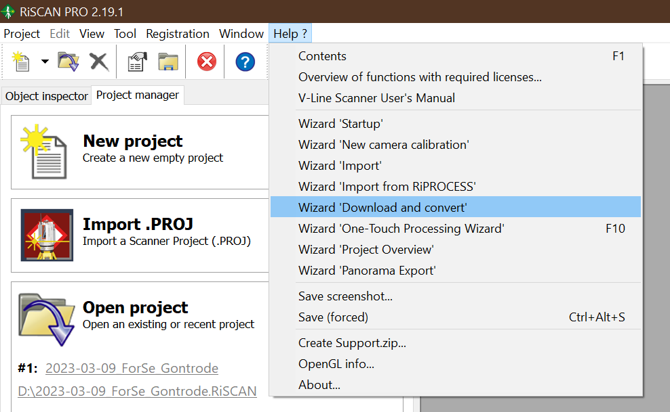
Import & convert
To import and convert the raw data click Help ?.
Click Wizard ‘Download and convert’.
1
2

Slide 13
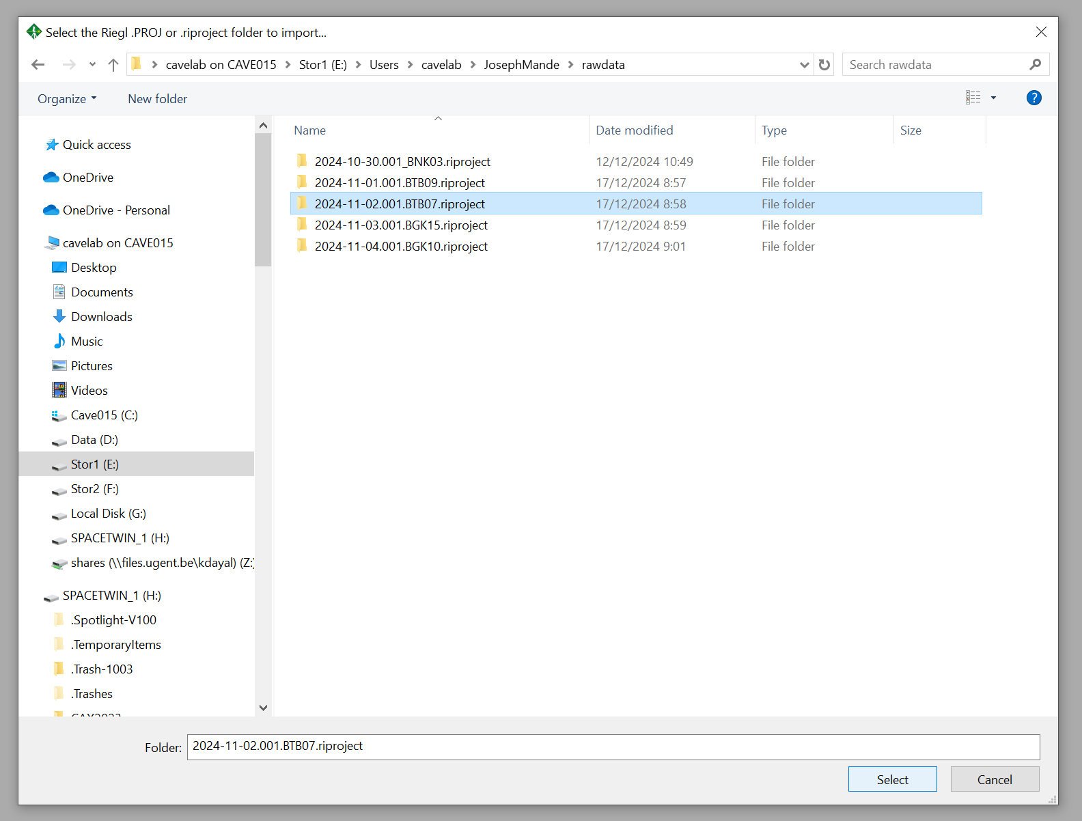
Import & convert
Select the raw data (*.riproject folder) that you want to process.
Click Select.
3
4

Slide 14
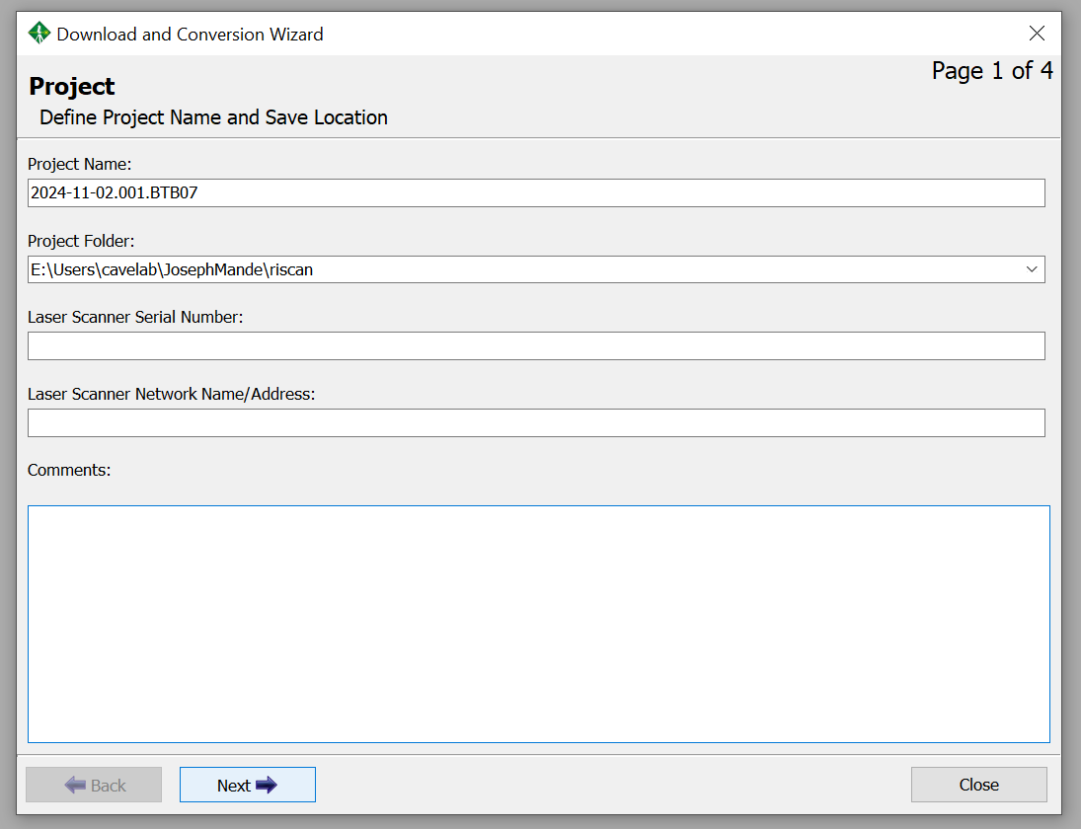
Import & convert
The project name will automatically be the same as the folder name (-.riproject) but this can be changed if wanted.
Choose the folder where you want to store the project.
Click Next.
5
6
7

Slide 15
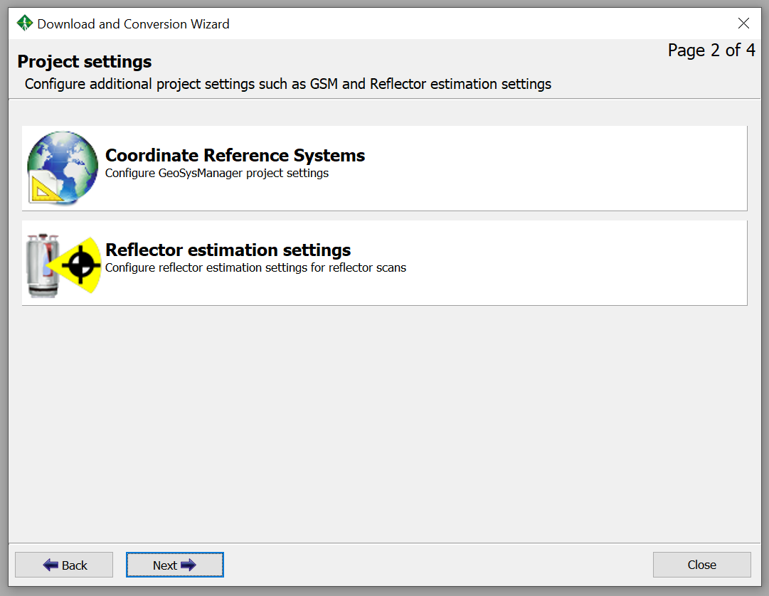
Import & convert
Click Next.
8

Slide 16
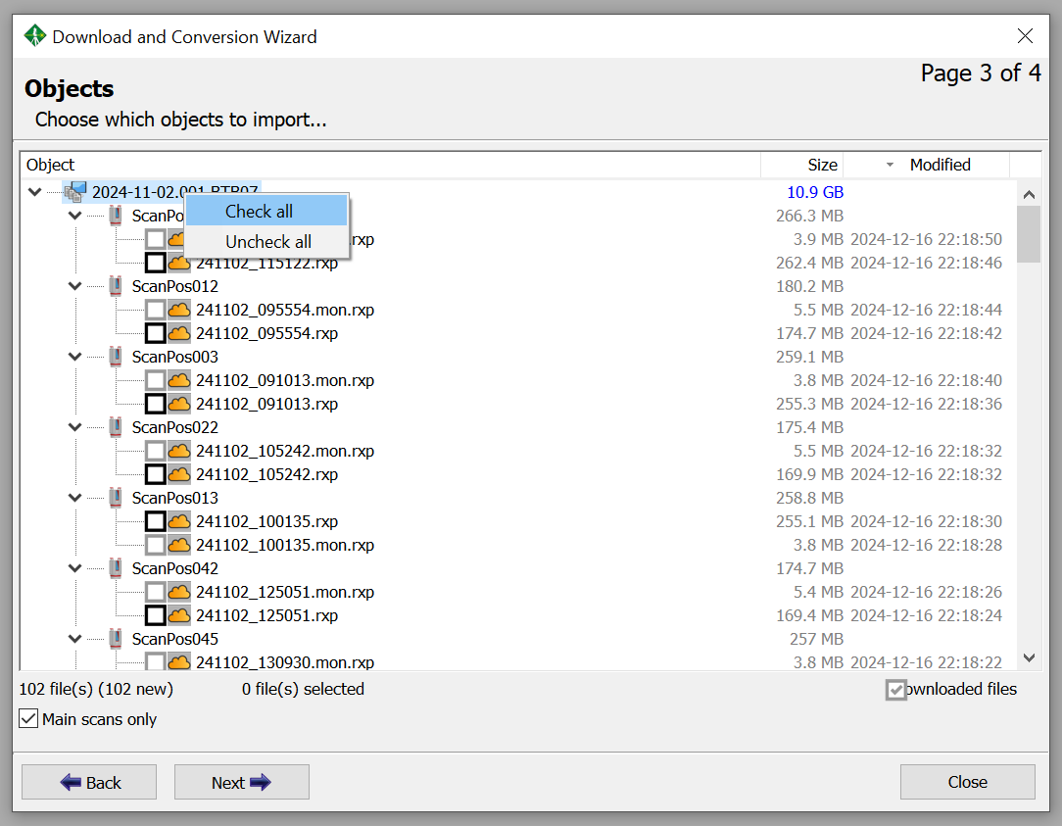
Import & convert
Right-click the project name.
Click Check all to select all scans.
Click Next.
9
10
11

Slide 17
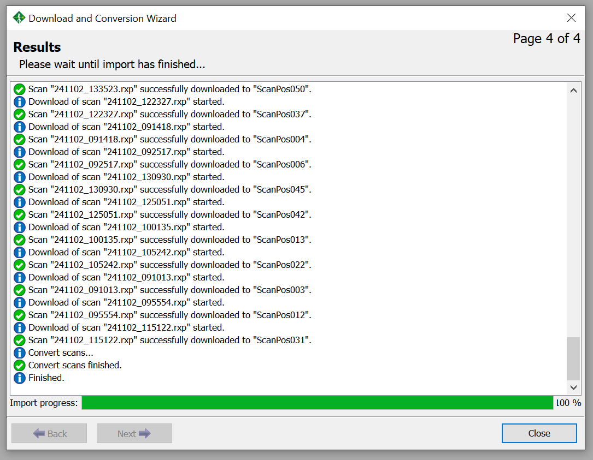
Import & convert
When the import progress is 100% click Close.
12

Slide 18
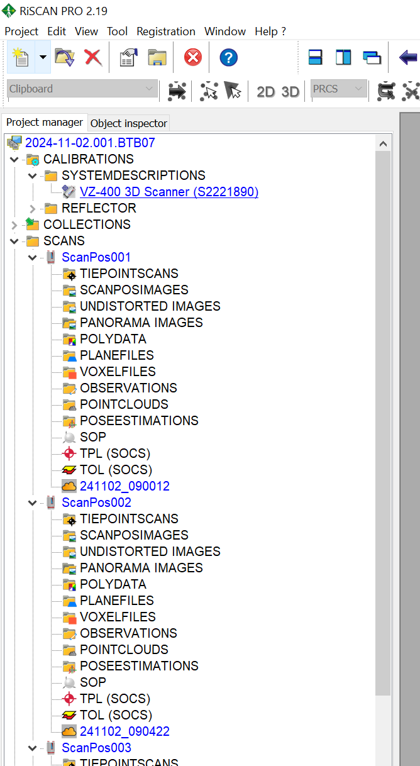
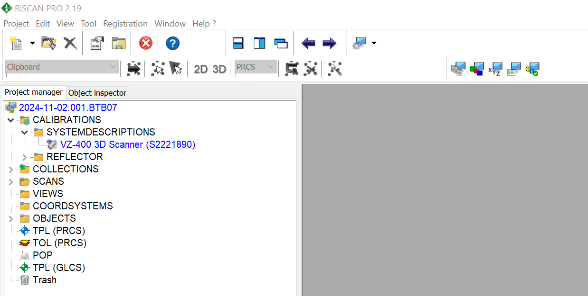
Import & convert
In the Project manager tab you can find all the data and objects.
The most important folder is SCANS.
There you can find all the scan positions (ScanPosXXX).
The actual point cloud/scan in each scan position is indicated by the symbol. The name of this file refers to the date and time the scan was taken.
13
14
14
15
15

Slide 19
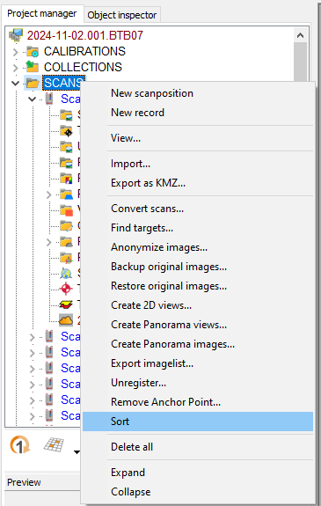
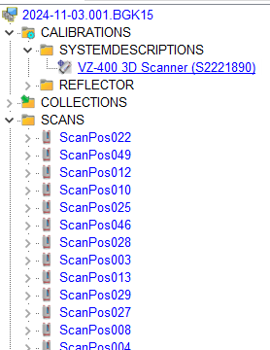
Import & convert
If the scan positions are in a strange order (e.g. not increasing from ScanPosition001 to ScanPosition002 etc.):
Right-click SCANS.
Click Sort.
16
16
17
17

Slide 20
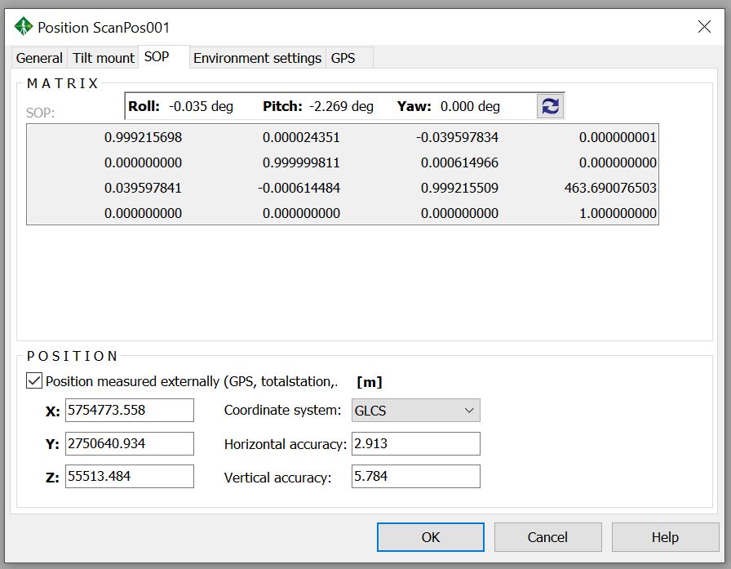
Import & convert
The orientation and position of the sensor during each scan is saved as a matrix in the SOP (Sensor's Orientation and Position) object of each scan position.
This matrix changes when we co-register the different scan positions.
X
Y
Z

Slide 21
Set SOP first scan
Before co-registration of the different scan positions we first determine the coordinate system of the first scan position which serves as our reference scan position to which the other scan positions will be aligned.

Slide 22
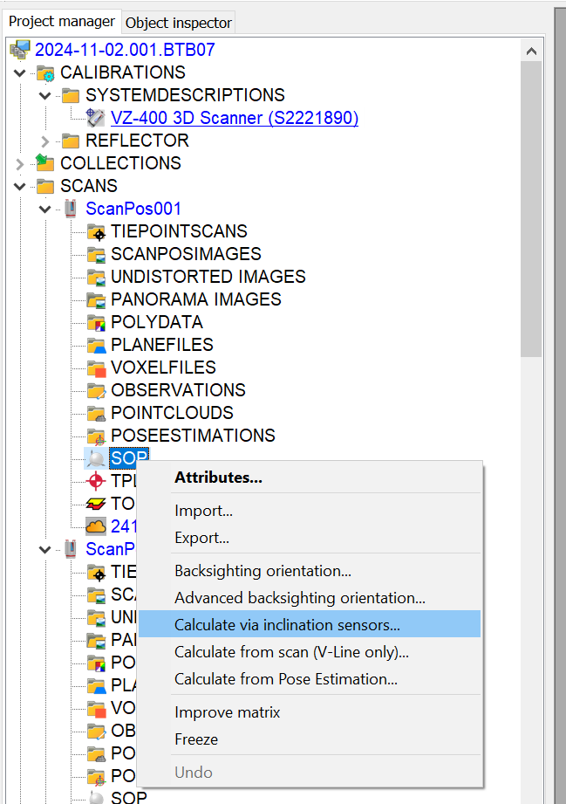
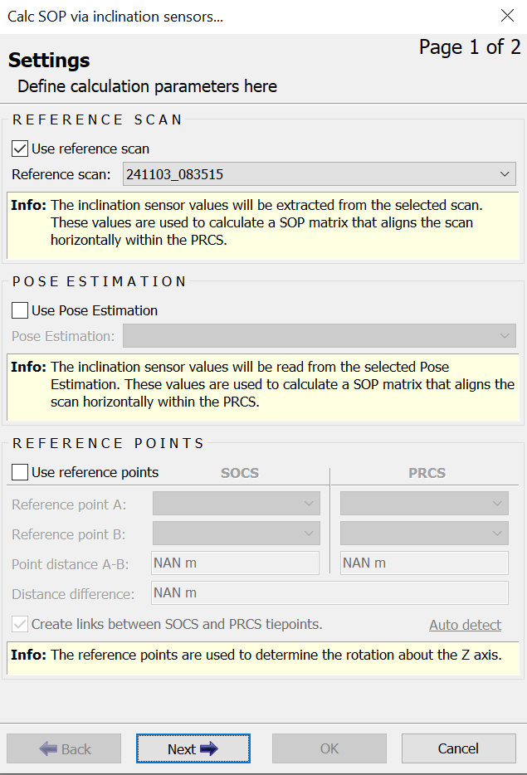
Set SOP first scan
20
Right-click SOP.
Click Calculate via inclination sensors...
Make sure it is set to Use reference scan.
Click next & OK.
18
21
19
Notes:
calculate via inclination sensors: LOCAL SYSTEM: only get roll, yaw, pitch (nothing to change, next (step 1) and OK (step 2))
calculate from scan (V-Line only): GLOBAL SYSTEM (WGS84/EPSG 4978): also get coordinates ²

Slide 23
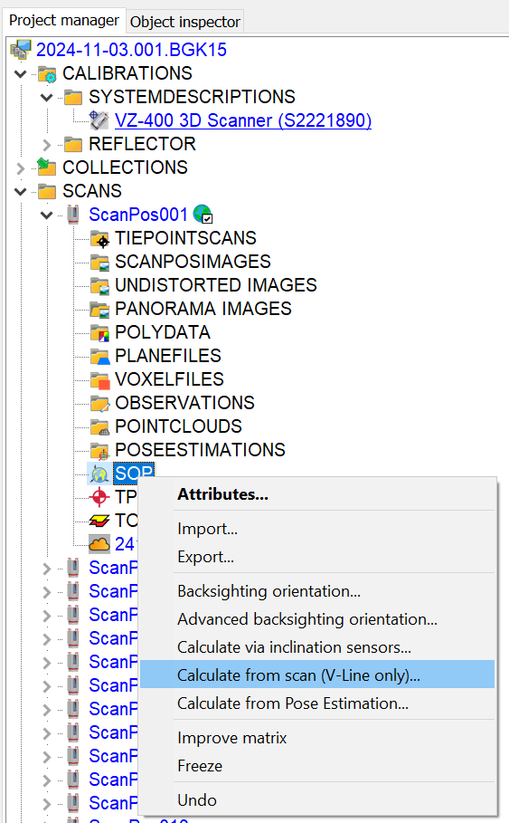
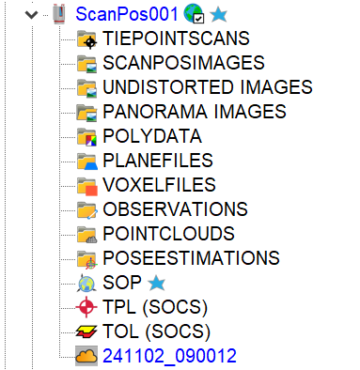
Set SOP first scan
Right-click SOP.
Click Calculate from scan (V-Line only)… Click OK.
Do step 1. again and click Freeze (when SOP is frozen it can't be changed).
A symbol will appear next to ScanPos001 indicating the SOP is frozen, and the indicates it’s registered.
22
25
23
24
Notes:
calculate via inclination sensors: LOCAL SYSTEM: only get roll, yaw, pitch (nothing to change, next (step 1) and OK (step 2))
calculate from scan (V-Line only): GLOBAL SYSTEM (WGS84/EPSG 4978): also get coordinates ²

Slide 24
PREPARATION
IMPORT & CONVERT
CLEAN & FILTER
FIND REFLECTORS
MAKE PLANE PATCHES
COARSE CO-REGISTRATION (TIE POINTS)
FINE CO-REGISTRATION (MSA1)
SAVE & COMBINE
STEPS

Slide 25
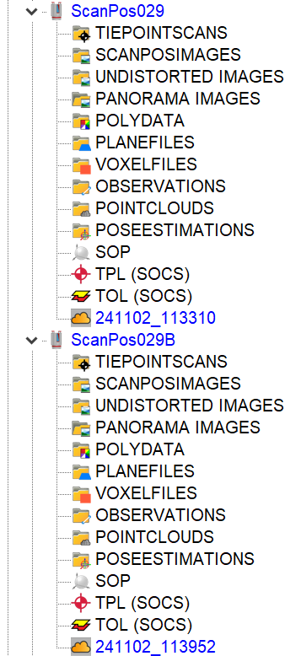
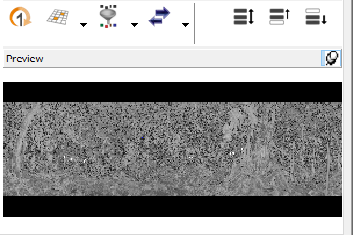
Clean
Sometimes (when there was wind or an error occurred during scanning in the field) multiple scans are conducted within one scan position or in separate scan positions. As we only need a single good scan, we delete the "bad" point clouds/scan positions.
The last point cloud/scan position is often the "good" one (in the example on the right the 029B will be the good one). But make sure you check by checking the field sheet and/or looking at the point cloud in the preview window (after clicking on the point cloud).

Slide 26
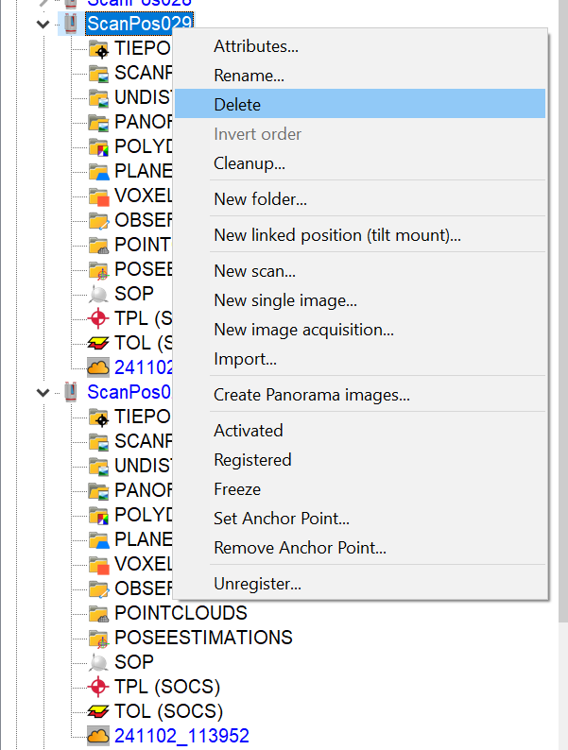
Clean
Right-click the scan position or point cloud which needs to be deleted.
Click Delete & confirm.
1
2

Slide 27
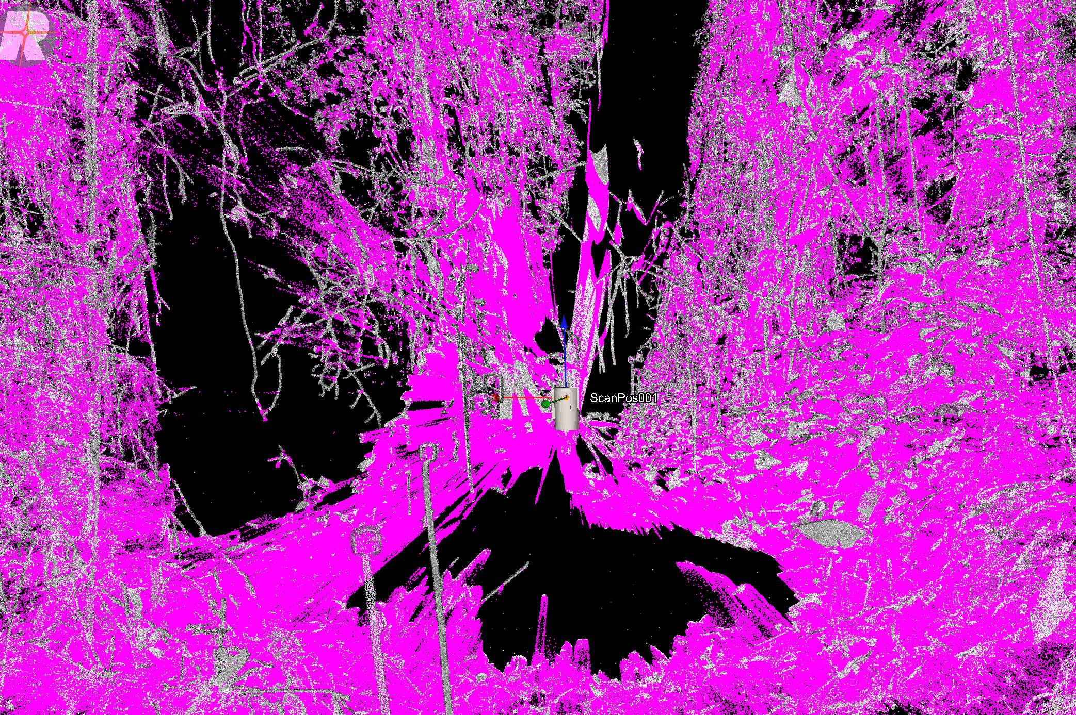
Filter
The point clouds in each scan position contain a lot of points and a big part of these point are of "bad" quality/noise. These points are characterised by a high deviation value (deviation quantifies the comparison of the recorded waveform with the stored reference shapes and this value increases for overlapping pulses or slanted targets).
Pink points in this figure have a deviation > 15.

Slide 28
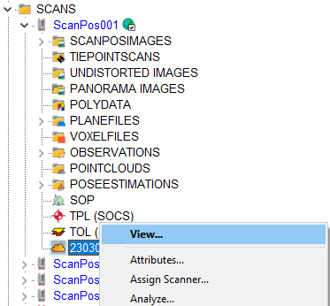
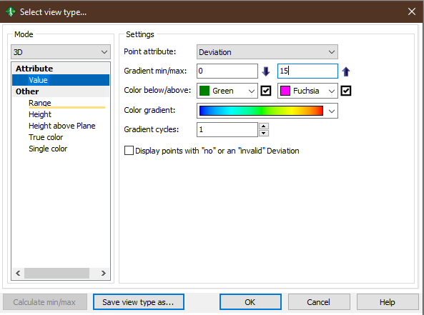
Filter
How to choose a max deviation value? Generally, we use a value between 12 and 20, standard 15. You can choose a value yourself by visualising and comparing the point cloud with different max deviation values to see the difference.
Right-click a point cloud.
Click View.
Click Value.
Choose Deviation.
Change the max value.
Click OK.
3
4
6
5
7
8

Slide 29
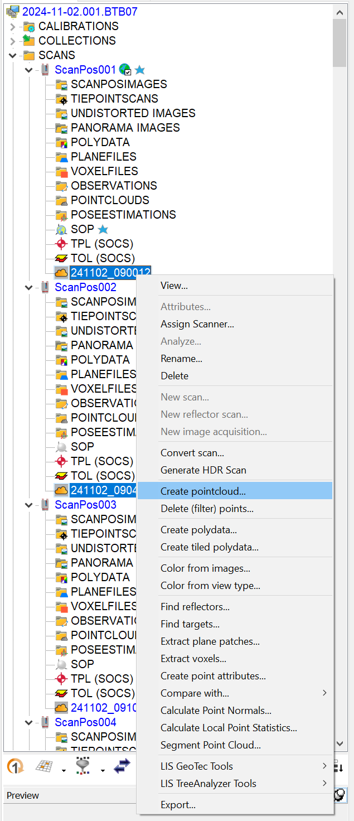
Filter
Select all the point clouds (see previous slides).
Right-click on the point cloud.
Click on Create pointcloud....
9-10
11

Slide 30
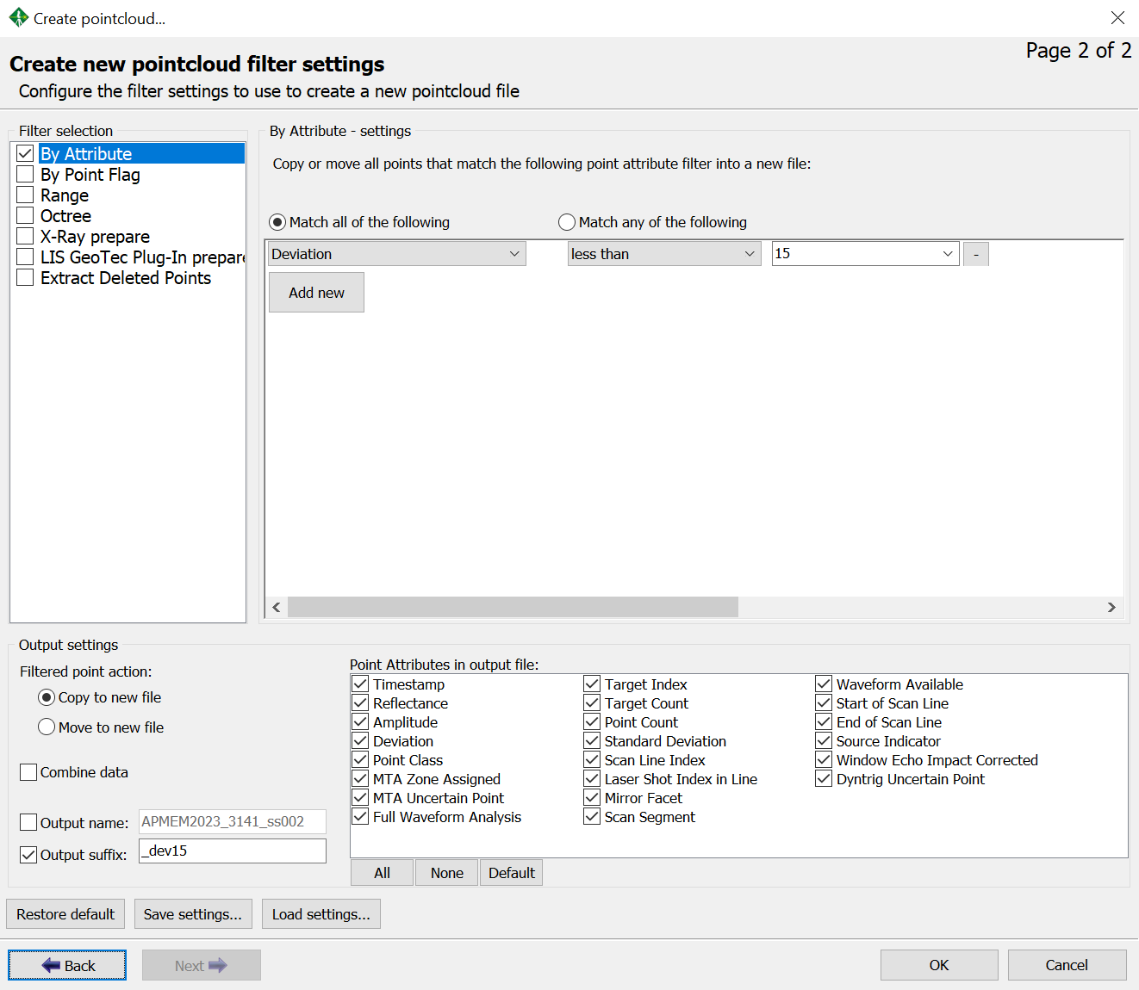
Filter
Check by Attribute.
Indicate Deviation less than 15 (this is what we use standard but can be case dependent).
Check Copy to new file.
Indicate an Output suffix such as _dev15 so it is clear how you created this point cloud.
Make sure Combine data is unchecked and click OK.
12
13
14
15
16

Slide 31
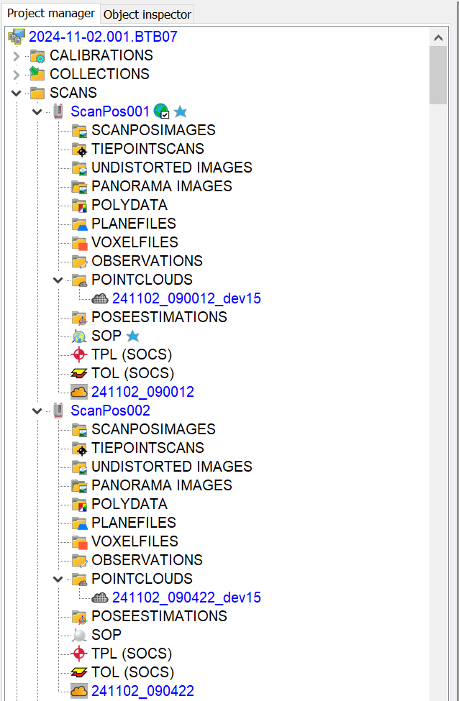
Filter
The point clouds with only points with a deviation < 15 end up under POINTCLOUDS for each scan position. These are the point clouds we will work with from now on (except to find the reflectors).
17

Slide 32
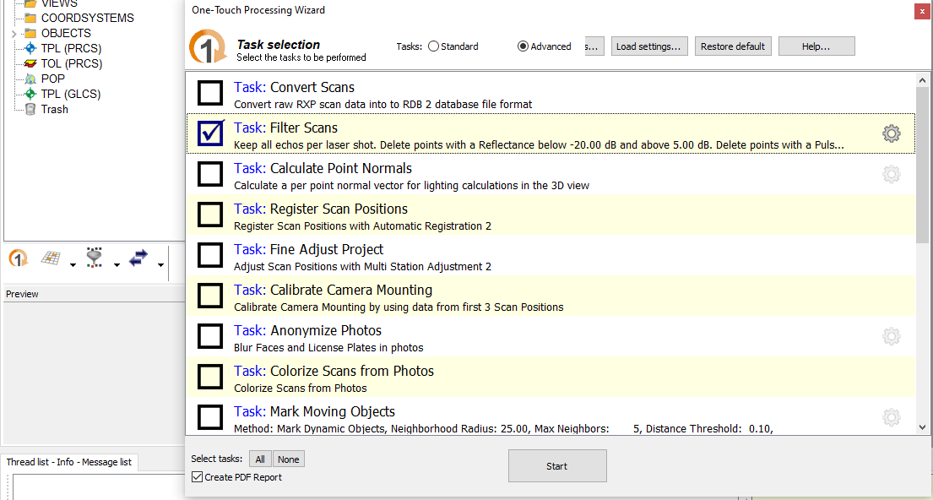
Filter
DO NOT PERFORM THESE STEPS IF YOU PERFORMED THE ONES IN THE PREVIOUS THREE SLIDES!!!
Alternatively, you could also use the One-touch processing wizard to filter your scans:
Click the wizard symbol.
Check Task: Filter Scans.
Click on the gear symbol.
2
3
1

Slide 33
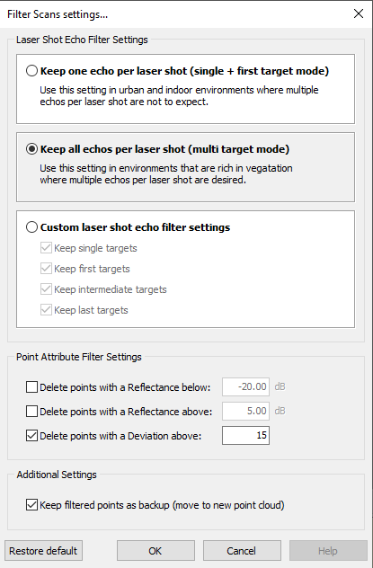
Filter
Check Keep all echos per laser shot.
Check Delete points with Deviation above. And fill in 15. Make sure the other filter settings are unchecked.
Check Keep filtered points as backup (move to new point cloud).
Click OK.
Make sure all other tasks in the wizard are unchecked and click Start.
4
5
6
7

Slide 34
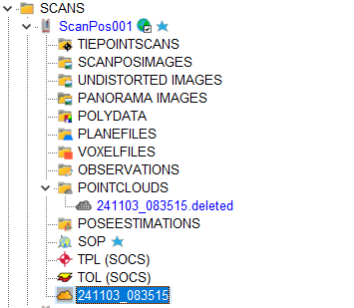
Filter
In this case the filtered version of the point cloud will be the cloud indicated by arrow 1 and the points that were deleted from that point cloud are found in POINTCLOUDS (arrow 2).
So if you use this method the next steps will have to be performed on the point cloud indicated by arrow 1. Pay attention to this as the next slides assume the previous option was used!
I recommend using the previous option.
10
9

Slide 35
PREPARATION
IMPORT & CONVERT
CLEAN & FILTER
FIND REFLECTORS
MAKE PLANE PATCHES
COARSE CO-REGISTRATION (TIE POINTS)
FINE CO-REGISTRATION (MSA1)
SAVE & COMBINE
STEPS

Slide 36
Find reflectors
In order to perform the coarse co-registration the reflectors placed in the forest need to be identified in the different scans.

Slide 37
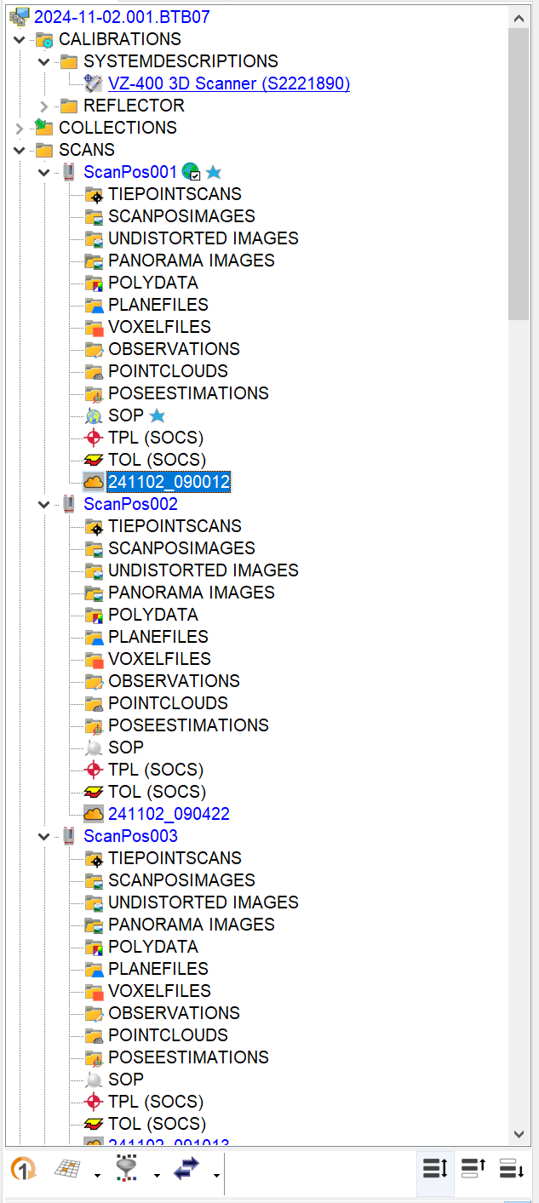
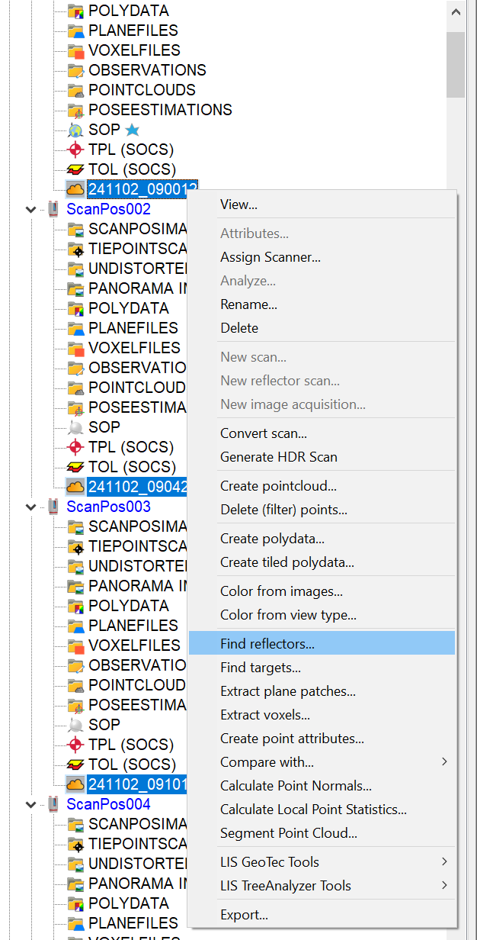

Find reflectors
2
Select all the point clouds by selecting one and clicking on symbol*.
Right-click on the point clouds.
Click on Find reflectors....
*this might not work on a froozen point cloud so select a different point cloud and try again and manually select the frozen point cloud (with ctrl + click).
1
3
1

Slide 38
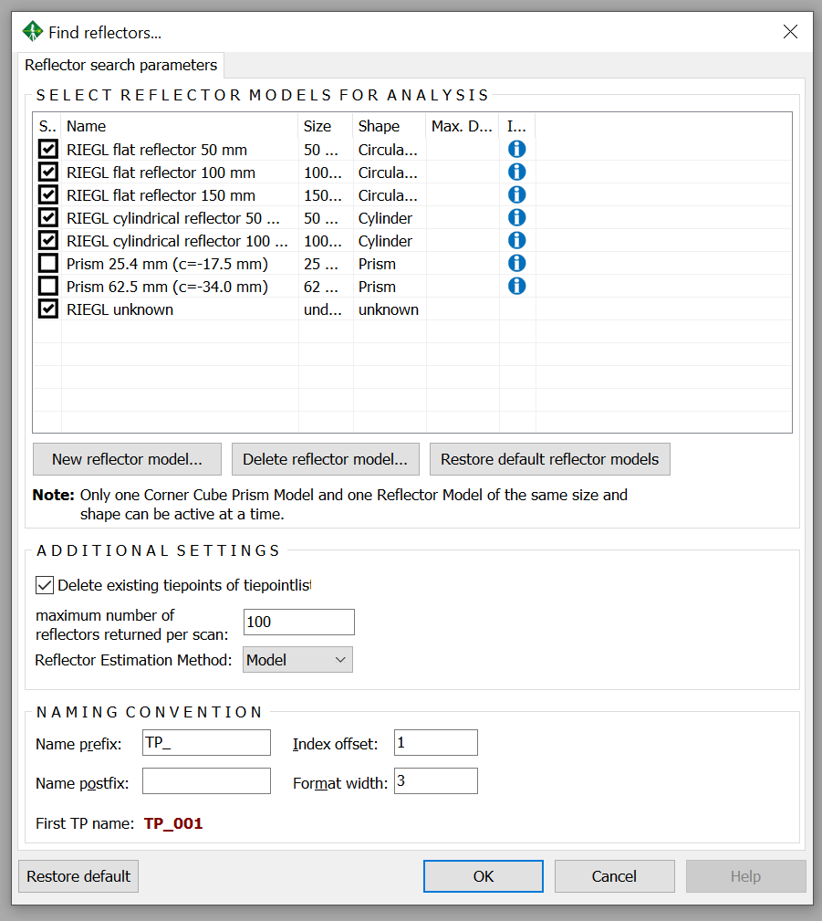
Find reflectors
Check all the RIEGL reflectors (this will increase the chance that reflectors are found).
Click OK.
4
5

Slide 39
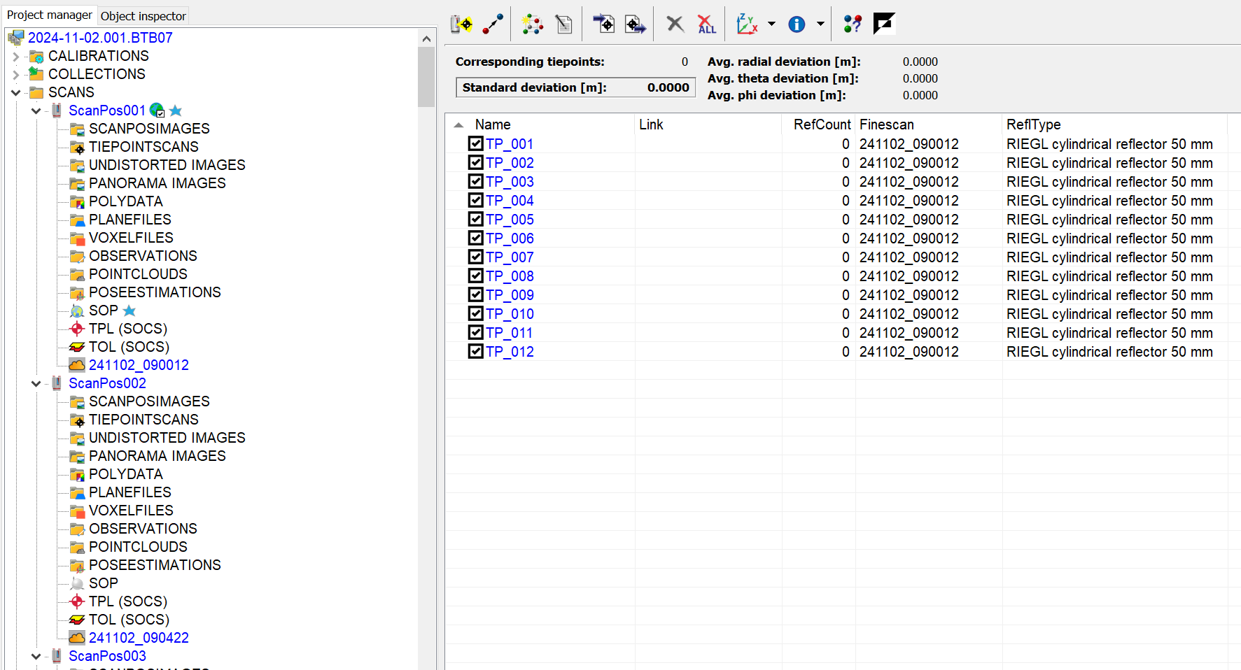
Find reflectors
The reflectors which are found for each scan position appear in TPL (tiepointlist), you can see them by double-clicking on TPL.
6

Slide 40
PREPARATION
IMPORT & CONVERT
CLEAN & FILTER
FIND REFLECTORS
MAKE PLANE PATCHES
COARSE CO-REGISTRATION (TIE POINTS)
FINE CO-REGISTRATION (MSA1)
SAVE & COMBINE
STEPS

Slide 41
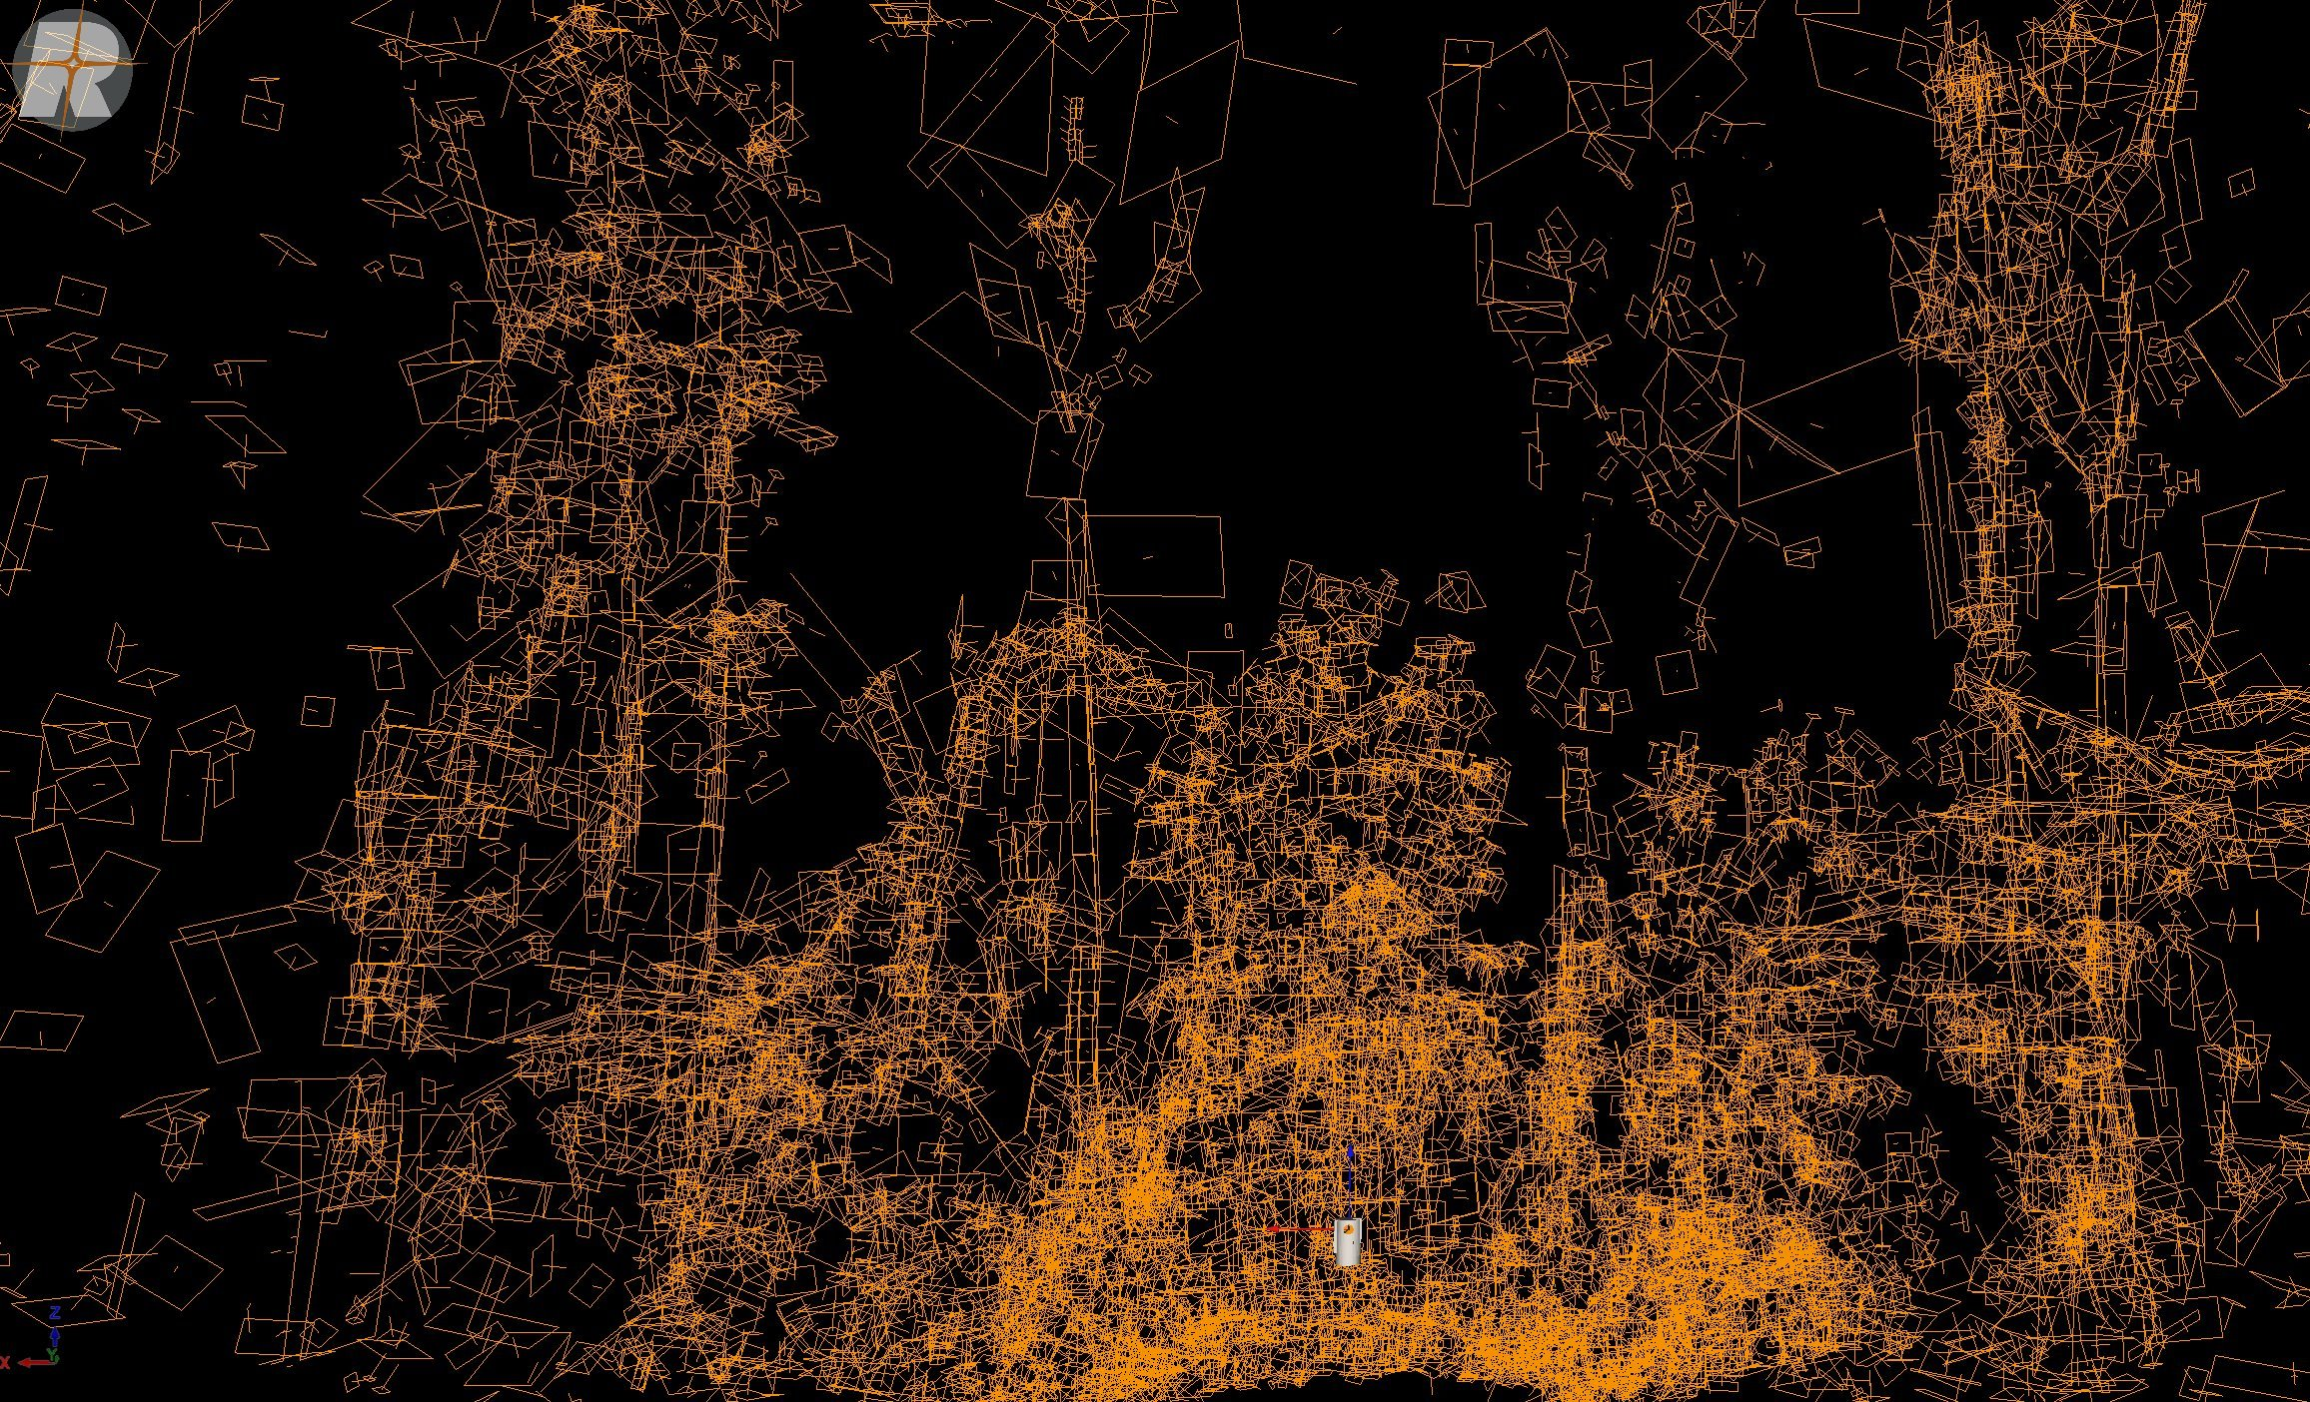
Plane patches
In order to perform the fine co-registration using the MSA algorithm we first need to calculate plane patches from each scan.
Illustration of plane patches. You can visualise plane patches after making them by clicking on them and dragging them into the gray area.

Slide 42
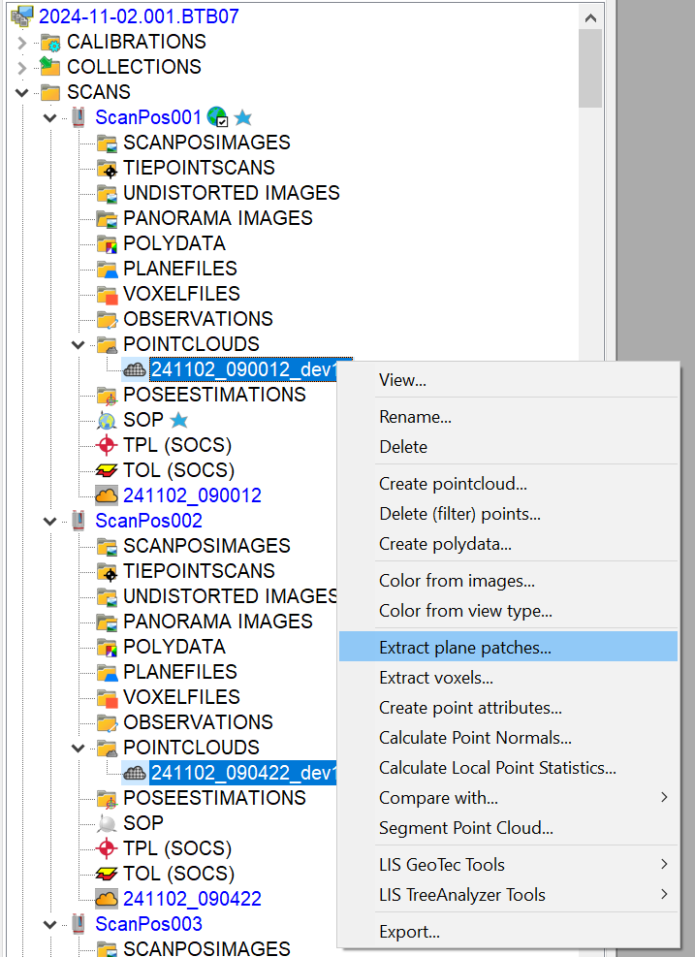
Plane patches
Select all the filtered point clouds under POINTCLOUDS by clicking on one and clicking on symbol.
Right-click on the filtered point cloud.
Click on Extract plane patches....
1-2
3

Slide 43
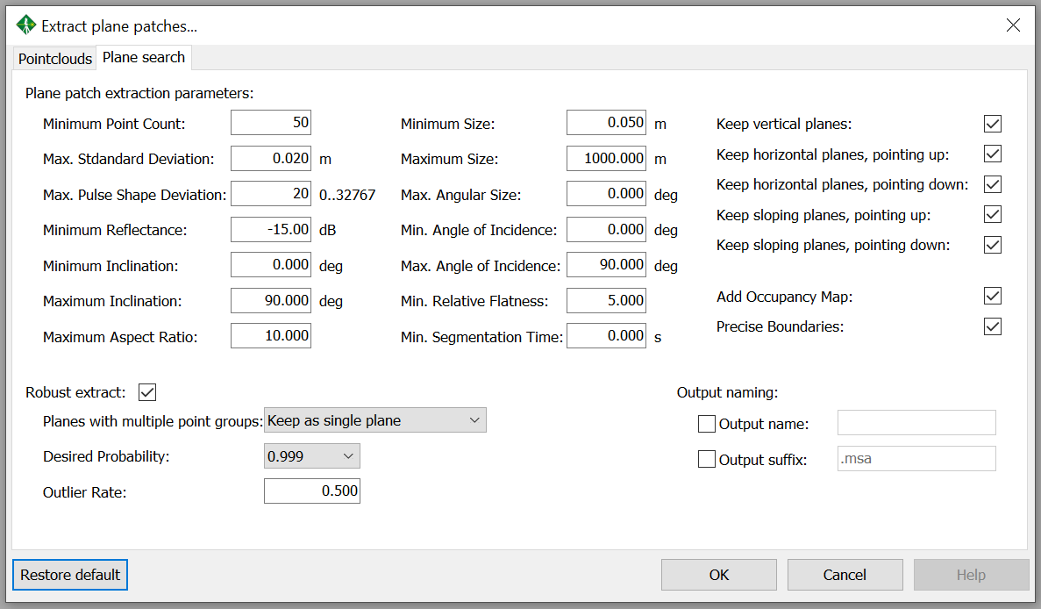
Plane patches
Default parameters are generally good enough for co-registration of TLS data, click Restore default to make sure the parameters are the default ones.
Click OK.
4
5

Slide 44
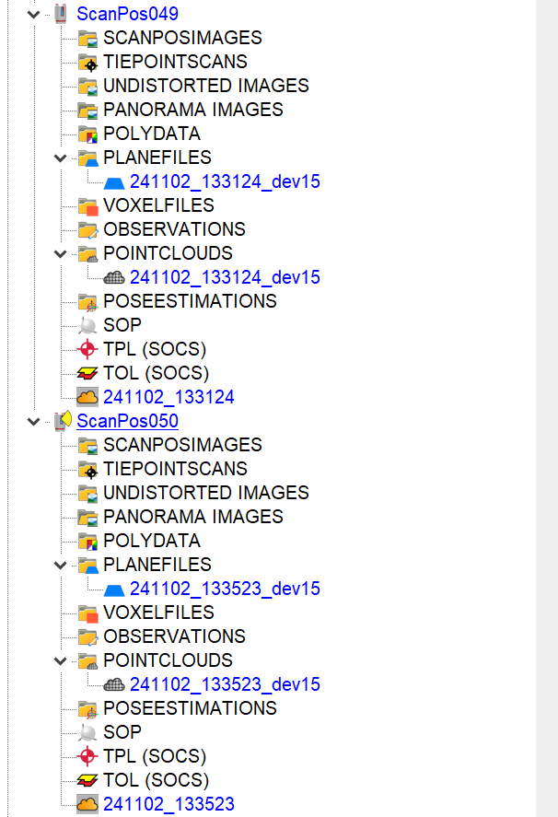
Plane patches
The plane patches can be found under PLANEFILES for each scan position.
6

Slide 45
PREPARATION
IMPORT & CONVERT
CLEAN & FILTER
FIND REFLECTORS
MAKE PLANE PATCHES
COARSE CO-REGISTRATION (TIE POINTS)
FINE CO- REGISTRATION (MSA1)
SAVE & COMBINE
STEPS

Slide 46
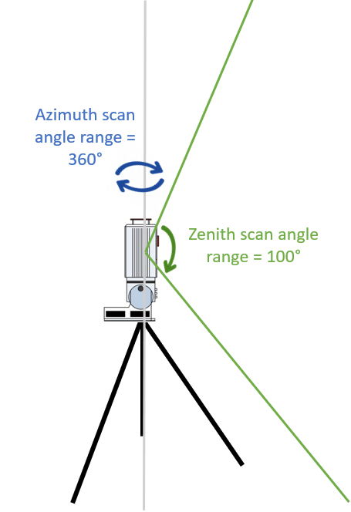
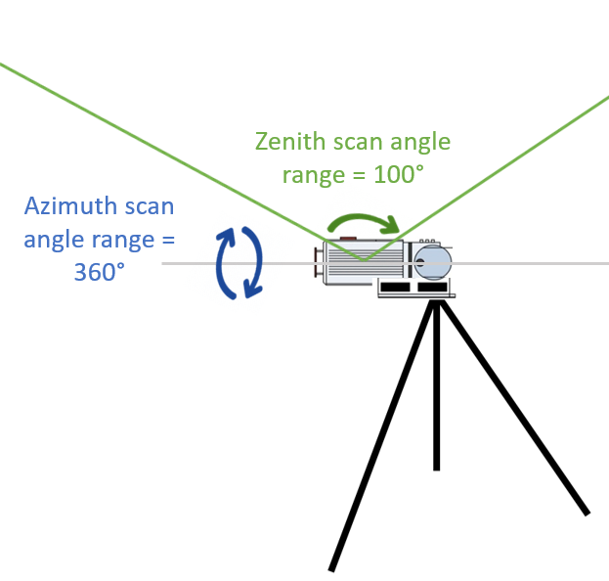
Coarse co-registration
The coarse co-registration consist basically of aligning scans based on common reflectors that were put in the field.
In practice, we perform 2 scans at each location (one up, one tilted) and then move to the next location while also moving half of the reflectors. Therefore the up and the tilted scans at one location can always be linked to each other using the reflectors AND they can be linked to the scans of the previous and next location.
Tilted scan
Upright scan

Slide 47
Coarse co-registration
While doing this coarse co-registration we follow the same sequence as how the scans were done:
ScanPos001 is the reference (and registered),
ScanPos002 is linked* to ScanPos001,
ScanPos003 can be linked to ScanPos001 and ScanPos002,
ScanPos004 can be linked to ScanPos001 and ScanPos002 and ScanPos003,
ScanPos005 can be linked to ScanPos003 and ScanPos004, etc.
See extra slides for more clarity.
*Using the coarse co-registration algorithm, you can only link a scan position to those that previously have been registered.

Slide 48
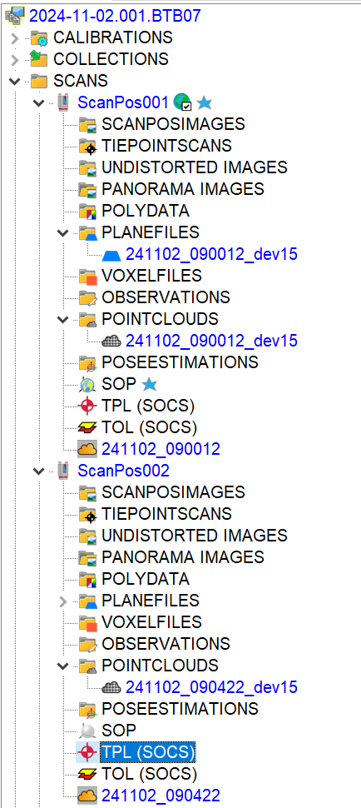
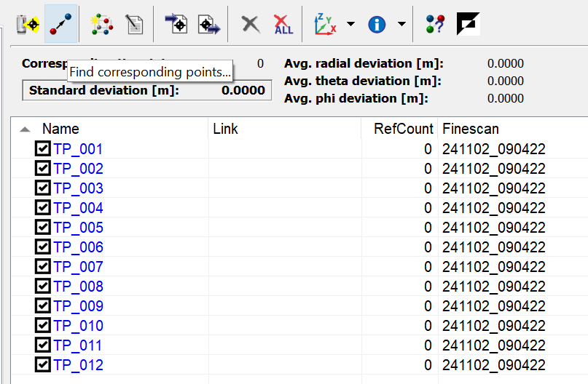
Coarse registration
1
We want to co-register/align ScanPos002 to ScanPos001 which is our registered reference. The symbol indicates that this scan position has been registered.
Double-click TPL under ScanPos002.
Click on Find corresponding points....
3
2

Slide 49
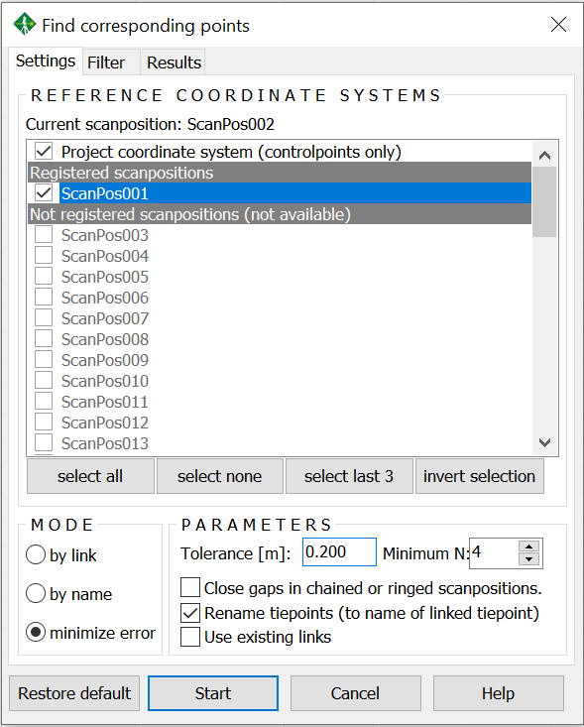
Coarse registration
Check ScanPos001 as this is the only "registered" scan position which ScanPos002 has reflectors in common with.
Set the parameters. To begin the tolerance can be set for example to 0.2 and minimum N to 4.
Click Start. Now the algorithm will search for solutions to match the reflectors (tie points) found in ScanPos002 to those found in ScanPos001.
4
5
6

Slide 50
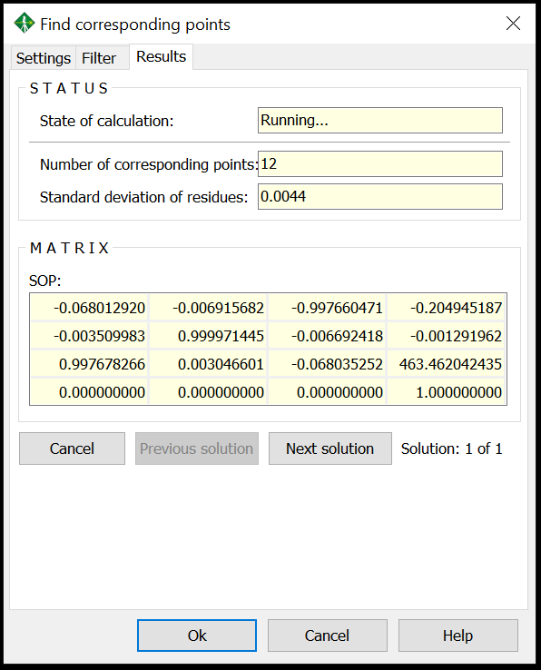
Coarse registration
7
This gives you all the solutions found with the first one usually the best one. It says it could match 12 tiepoints. This is likely to be a good solution.
To be sure you can visualise the point clouds of ScanPos001 and ScanPos002 to confirm (see next slides). OR if you know the pattern of the scans you could also just visualise the SOPs (select them and drop them into the viewer).

Slide 51
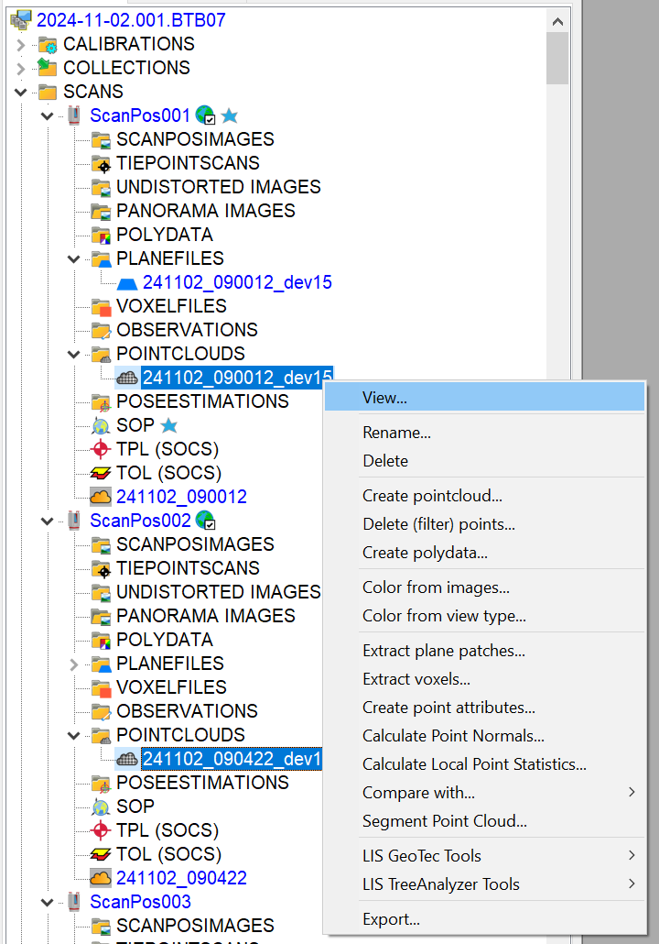
Visualise point clouds
Visualising the point clouds:
Select the point clouds you want to visualise. Right-click on one of the point clouds.
Click on View... (or drag and drop them into the grey area).
1
2

Slide 52
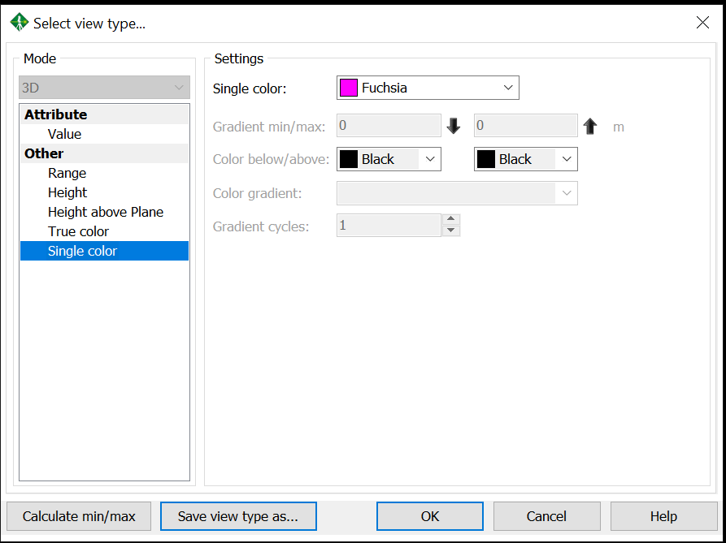
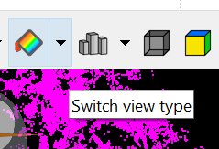
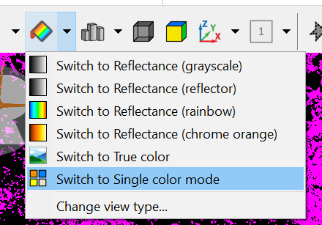
Visualise point clouds
Choose the setting Single color.
Click OK.
Click Switch view type.
Click Switch to Single color mode. This will show the point clouds of different scan positions in different colors.
3
4
5
6

Slide 53
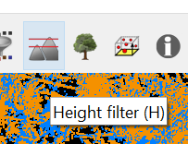
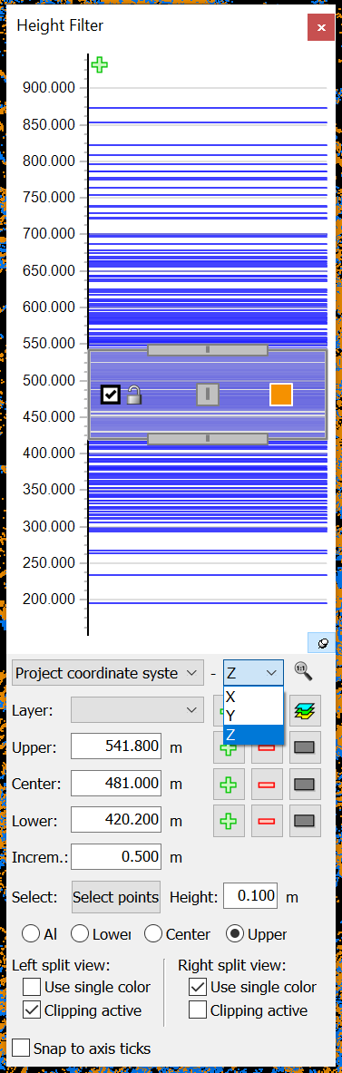
Visualise point clouds
8
Use the scroller to zoom in and out of the point cloud.
You can use the Height filter to slice the point cloud to better focus on certain parts of the point cloud.
You can make horizontal slices (Z), or vertical slices (X or Y) through the point cloud.
You can change the height range and thickness of the slices.
Play around with this a bit.
9
10

Slide 54

Visualise point clouds
The two colors are coarsely matching meaning it is a good solution.

Slide 55

Visualise SOPs
You can also just visualise the SOPs
Select the SOPs you want to visualise.
Drag and drop them into the grey area.
11
12

Slide 56


Visualise SOPs
15
Click on Orthogonal view: this will give you grid lines where you can see the scan positions locations (which are 10 m apart as expected here). Moreover, even and uneven scan positions (e.g 001 and 002) are on top of eachother as these are the upright and tilted scans at one location.

Slide 57
Coarse registration
If the solution is good you click OK.
If the solution is not good you can click on Next solution. And you check if it is better. You can keep clicking till a good solution is found.
If you run out of solutions without finding a good one you click on Settings. Increase the tolerance with 0.1. If this does not work you can also decrease the Minimum N to 3. This is a bit of a trial and error process.
If it still does not find any good solutions, manual methods will need to be used (see slides at the end).
10
9
8

Slide 58
PREPARATION
IMPORT & CONVERT
CLEAN & FILTER
FIND REFLECTORS
MAKE PLANE PATCHES
INITIAL CO- REGISTRATION (TIE POINTS)
FINE CO-REGISTRATION (MSA1)
SAVE & COMBINE
STEPS

Slide 59

Fine co-registration
After the coarse co-registration, the point clouds are matching but there's still an error on this. To improve the co-registration (reduce this error), we use the MSA algorithm which uses plane patches to match the different scans more closely.
This can be done after one or multiple scan positions are coarsely registered. The next slides are based on doing the fine registration after one scan position has been coarsely registered.
This shows you an example of the error which may be left after coarse co-registration.

Slide 60

Fine co-registration
Click Registration.
Click Multi Station Adjustment.
Click Start adjustment....
1
2
3

Slide 61

Fine co-registration
4
5
Make sure the registered scan positions are activated by selecting them and right-click.
Click Activate. A check symbol will apear left next to the scan (see next slide).
Make sure the other scan positions which haven't been registered yet are deactivated. If they are activated (checked) do step 1 and click Deactivate.
6

Slide 62


Fine co-registration
7-8
Make sure the registered scan positions which have already gone through fine co-registration are locked by selecting them and right-click.
Click on Lock position and orientation. Froozen scan positions (such as ScanPos001) are automatically locked.

Slide 63

Fine co-registration
9
Make sure the scan position which you want to finely co-register is unlocked by selecting it and right clicking.
Click on Unlock position and orientation.
10

Slide 64

Fine co-registration
11
Under INPUT DATA make sure Use plane patches is indicated. Ignore the tiepoint, tieobjects and measured scan positions.
Under PARAMETERS the most important one is search radius (which you should choose as the distance you think the error between the two scans is approximately). The other parameters can generally stay unchanged. More info on the different parameters is found on the next slide.
12

Slide 65

Fine co-registration

Slide 66


Fine co-registration
To start the adjustment, you set your parameters based on the error you observe.
Click Calculate.
It can be good to visualise your point clouds (ScanPos001 and ScanPos002 in this case) to see if the adjustment is going the right way.
13
14

Slide 67

Fine co-registration
15
The numbers under ΔX, ΔY, ΔZ, ΔRoll etc. show how much the SOP changed (the point cloud translated and rotated).
Under STATISTICS, the Error (StdDev) [m] also gives an idea of the resulting error.
16

Slide 68

Fine co-registration
Generally an Error (StdDev) [m] </= 1 cm is good. So you can reduce the Search radius to approximately 2 times the error.
Click Calculate.
Repeat the process till the co-registration looks good/doesn’t really change anymore.
17
18

Slide 69

Fine co-registration
20
Now the error is below 1 cm. This scan position is finely registered now.
Right-click the scan position.
Click Lock position and orientation.
IF something went wrong during the MSA adjustment you can undo an adjustment by clicking Undo last (which undoes the last adjustment) or Undo all (which undoes everything you did since you opened the MSA screen).
21
19
22
22

Slide 70
Coarse & Fine co-registration
Now you repeat the coarse and fine registration steps with the next scan position till all the scan positions are finely co-registered.
Because of this sequential process errors can propagate towards the end of the scan positions. Therefore it's advised to run MSA algorithm once more on all the scan positions (see next slides).

Slide 71

Fine co-registration
24
Open MSA (see previous slides).
Activate all scan positions (see previous slides).
Unlock all scan positions (see previous slides) expect for ScanPos001 which is frozen.
Set the Search radius [m] to a low number such as 5 cm.
Click Calculate.
26
25
27

Slide 72

Fine co-registration
It is important to visually check the results of the final co-registration.
Visualise all point clouds in different colors (see previous slides).
Set Top view.
Set Orthogonal view.
Rotate the point clouds so they are aligned with the X-Y axis in the grid.
Click Selection mode > Shape > Rectangle selection.
Select the plot based on the scan positions you see.
33
33
30
31

Slide 73

Fine co-registration
Click Show only selected area.
Click the Height filter.
35
36

Slide 74


Fine co-registration
39
Use the Height filter to take slices through the plot in both X, Y and Z.
Go through the plot and check the point clouds of different scan positions (in different colors) are matching.
If something is off try to correct it using MSA. (See next slide to know wether it can be fixed or not.)
39

Slide 75

Fine co-registration
When is something bad registration (and can be fixed) and when is it just wind (and cannot be fixed)?
When you see ghosting effects (an object is in the point cloud multiple times on a slightly different position in different scans) that are mostly present in the branches but not in the stems, with the effect bigger towards the top, this is most likely due to wind. Leaves can easily be moved by wind, therefore we focus on stems to check wether the co-registration is OK.
Ghosting (see pink point cloud – compared to the other colors).

Slide 76


Slide 77
PREPARATION
IMPORT & CONVERT
CLEAN & FILTER
FIND REFLECTORS
MAKE PLANE PATCHES
INITIAL CO-REGISTRATION (TIE POINTS)
FINE CO- REGISTRATION (MSA1)
SAVE & COMBINE
STEPS

Slide 78
Save
If you have finished the co-registration it is important that you make a backup of the SOP matrices. There are two ways to save the SOPs which you should both perform:
Saving them separately in .DAT files
Saving them combined in a CSV file*
This is also essential for your data management which is compulsory in Q-ForestLab.
*You can also do this during the co-registration process when you want the current status of the SOPs to be back-upped. This could be useful before performing MSA on the whole plot as this might also give unwanted results and by saving the SOPs on beforehand you can easily undo the changes made.

Slide 79


Save
1
First way to save SOPs
Click on Registration.
Click on Multiple SOP export….
Check the Export complete 4x4 matrix as *.DAT. Uncheck the other options.
Click OK.
2
3
4

Slide 80

Save
If you left the target folder unchanged then the SOP files will end up in the project folder (*.RiSCAN)

Slide 81



Save
1
Second way to save SOPs
Click on Registration.
Click on SOP backup….
Choose a good backup name (e.g. dates if you’re making intermediairy backups; name of the .RiSCAN PROject for your final backup).
Click Create backup.
If you ever want to restore a backup, double click the name of the one you want to restore.
2
3
4
5

Slide 82

Save
The CSV file created by doing the steps in the previous slide ends up in the *.RiSCAN folder under BACKUP > SOP

Slide 83
Combine
In a next step you might want to combine the point clouds of all the scan positions into one big point cloud. From this point cloud you can later extract trees or structural features.
This combined point cloud will contain a lot of points, therefore it is often advised to downsample the point cloud. Often a downsampling resolution of 1 cm to 2 cm is used considering the file size, the characteristics of the VZ-400 scanner, and the forest.

Slide 84


Combine
Select all the filtered point clouds under POINTCLOUDS by clicking on one and clicking on symbol.
Right-click on the filtered point cloud.
Click on Create pointcloud....
2
3

Slide 85

Combine
Check Octree.
Choose your Resolution.
Click Copy to new file.
Check Combine data.
Choose an Output name:.
Click OK.
2
4
5
6
7
8
9

Slide 86

Combine
Click on the One-touch processing wizard.
Check Task: Generate Octree based Point Clouds. Make sure other tasks are unchecked.
Click on the symbol.
2
3
1

Slide 87

Combine
Choose one or multiple resolutions. Multiple will make multiple point clouds.
Check Keep Deviation. Uncheck the rest.
Click OK.
Click Start.
1
2
4
3

Slide 88

Combine
The combined point clouds will end up under OBJECTS > POINTCLOUDS.
7
7

Slide 89
MANUAL COARSE CO-REGISTRATION
EXTRA

Slide 90
Manual coarse co-registration
Sometimes it is impossible to coarsely co-register some scan positions. This can happen when too many reflectors were not visible in a scan. In that case you need to manually fix the co-registration.
There's two cases:
Problems with co-registration of the tilted scan. This can be easily fixed when the upright scan at the same location is registered.
Problems with co-registration of the upright scan. This is more tricky.

Slide 91

Manual coarse co-registration
Fixing case 1 (tilted scan) - option 1
One way to manually co-register a tilted scan is by manually picking tiepoints in the upright an tilted scan at the same location.
First we need to visualise the upright and tilted scan in 2D view:
Right-click the point clouds of the scan position you want to co-register.
Click View.
2
1
Notes:
Need to finish these slides

Slide 92

Manual coarse co-registration
Fixing case 1 (tilted scan) - option 1
Click 2D.
Click Reflectance.
Click OK.
Right-click the point cloud of the upright scan position at the same location (so the previous scan position)
Click View.
Click 2D.
Click Reflectance.
Click OK.
3
4
5
Notes:
Need to finish these slides

Slide 93

Manual coarse co-registration
Fixing case 1 (tilted scan) - option 1
1. Rotate the tilted scan view so it's similar to the upright scan view
11
Notes:
Need to finish these slides

Slide 94

Manual coarse co-registration
Fixing case 1 (tilted scan) - option 1
1. Minimize and adapt the screen sizes so you can see both views next to each other.
Notes:
Need to finish these slides

Slide 95


Manual coarse co-registration
Fixing case 1 (tilted scan) - option 1
Move around in the view to get a similar area in both views. Zoom in on a similar object in both views
Right-click on that object in one of the views
Click Create tiepoint here.
Click OK.
Do the same in the other view on the same object.
14
15
Notes:
Need to finish these slides

Slide 96
Manual coarse co-registration
Fixing case 1 (tilted scan) - option 1
Repeat the process in the previous slide approximately three to five times, choosing objects at different heights and ranges.
Then rotate the tilted scan again to see the other side of the scan and repeat step 1.
2
3
Notes:
Need to finish these slides

Slide 97
Manual coarse co-registration
Fixing case 1 (tilted scan) - option 1
Now you have created a number of additional tiepoints in both the (registered) upright scan and the unregistered tilted scan. You can go back to the coarse registration steps in previous slides and try to find corresponding tiepoints again.
Notes:
Need to finish these slides

Slide 98
Manual coarse co-registration
Fixing case 2 (upright scan) - option 1
One way to fix an upright scan is by manually moving the scan position to the right spot.
But before we do this we want the scan position to be “tilted” the right right way (up). This might not be the case after trying coarse registration using the tiepoints. To do this we will use the SOP of the previously registered scan position (see next slide).
Notes:
Need to finish these slides

Slide 99

Manual coarse co-registration
Fixing case 2 (upright scan) - option 1
Right-click the SOP of the previously registered upright scan position.
Click Export. Save the SOP in a place you can quickly find again (e.g. Downloads) and save it under a logical name (e.g. sop019.dat).
1
2
Notes:
Need to finish these slides

Slide 100

Manual coarse co-registration
Fixing case 2 (upright scan) - option 1
Right-click the SOP of the upright scan position you want to manually co-register.
Click Import. Choose the previously exported SOP.
Now the scan position will be on the exact same position as the previous upright scan position. And we need to move it towards the spot we think it should be.
3
4
Notes:
Need to finish these slides

Slide 101

Manual coarse co-registration
Fixing case 2 (upright scan) - option 1
Visualise the SOPs of all the registered scan positions in the Orthogonal view and put the view in Top view. (see previous slides). Now you can see the scan pattern. Based on this and your knowledge of the field work estimate where the scan position should approximately be.
Right-click on the scan position you want to move under POSITIONS in the Object inspector.
Click Modify orientation & position in 3D view….
Notes:
Need to finish these slides

Slide 102

Manual coarse co-registration
Fixing case 2 (upright scan) - option 1
Click on the blue shaded area of the blue donut that appeared. And move it to the position you think the scan should be.
You can use a sliced view to see more clearly if the point clouds are also visualised.
8
Notes:
Need to finish these slides

Slide 103


Manual coarse co-registration
Fixing case 2 (upright scan) - option 1
Look for identical objects in the point cloud of the scan position you want to co-register and the already registered scan positions.
Use the blue cylinder thing to translate (shaded area for X,Y and the arrow for Z) and rotate (the band) the scan position so it matches the other point clouds approximately.
Click Apply.
11
9
10
Notes:
Need to finish these slides

Slide 104

Manual coarse co-registration
Fixing case 2 (upright scan) - option 1
Now the upright scan has been very coarsly registered. To indicate this:
Right-click the scan position.
Click Registered.
Now use the fine registration steps (MSA1) explained in previous slides to finely register the scan position.
Notes:
Need to finish these slides

Slide 105



Slide 106
VISUALISATION SCANNING & COARSE CO-REGISTRATION PATTERN
EXTRA

Slide 107

Visualisation pattern
Notes:
Need to finish these slides

Slide 108



5 m
In case of scanning a 30 m x 30 m plot using 12 reflectors
Situation ScanPosition001
Reference scan position (already registered)
Scan locations
Reflectors
Upright scan
Tilted scan

Slide 109
5 m
Situation ScanPosition002
Already registered & common reflectors? 001
Scan locations
Reflectors
Upright scan
Tilted scan

Slide 110
5 m
Situation ScanPosition003
Already registered & common reflectors? 001, 002
Scan locations
Reflectors
Upright scan
Tilted scan

Slide 111
5 m
Situation ScanPosition004
Already registered & common reflectors? 001, 002, 003
Scan locations
Reflectors
Upright scan
Tilted scan

Slide 112
5 m
Situation ScanPosition005
Already registered & common reflectors? 003, 004
Scan locations
Reflectors
Upright scan
Tilted scan

Slide 113
5 m
Situation ScanPosition006
Already registered & common reflectors? 003, 004, 005
Scan locations
Reflectors
Upright scan
Tilted scan

Slide 114
5 m
Situation ScanPosition007
Already registered & common reflectors? 005, 006
Scan locations
Reflectors
Upright scan
Tilted scan

Slide 115
5 m
Situation ScanPosition008
Already registered & common reflectors? 005, 006, 007
Scan locations
Reflectors
Upright scan
Tilted scan

Slide 116
5 m
Situation ScanPosition009
Already registered & common reflectors? 007, 008
Scan locations
Reflectors
Upright scan
Tilted scan

Slide 117
5 m
Situation ScanPosition0010
Already registered & common reflectors? 007, 008, 009
Scan locations
Reflectors
Upright scan
Tilted scan

Slide 118
5 m
Situation ScanPosition011
Already registered & common reflectors? 009, 010
Scan locations
Reflectors
Upright scan
Tilted scan

Slide 119
5 m
Situation ScanPosition012
Already registered & common reflectors? 009, 010, 011
Scan locations
Reflectors
Upright scan
Tilted scan

Slide 120
5 m
Situation ScanPosition013
Already registered & common reflectors? 011, 012
Scan locations
Reflectors
Upright scan
Tilted scan

Slide 121
5 m
Situation ScanPosition014
Already registered & common reflectors? 011, 012, 013
Scan locations
Reflectors
Upright scan
Tilted scan

Slide 122
5 m
Situation ScanPosition015
Already registered & common reflectors? 013, 014
Scan locations
Reflectors
Upright scan
Tilted scan

Slide 123
5 m
Situation ScanPosition016
Already registered & common reflectors? 013, 014, 015
Scan locations
Reflectors
Upright scan
Tilted scan

Slide 124
5 m
Situation ScanPosition017
Already registered & common reflectors? 015, 016
Scan locations
Reflectors
Upright scan
Tilted scan

Slide 125
5 m
Situation ScanPosition018
Already registered & common reflectors? 015, 016, 017
Scan locations
Reflectors
Upright scan
Tilted scan

Slide 126
5 m
Situation ScanPosition019
Already registered & common reflectors? 017, 018
Scan locations
Reflectors
Upright scan
Tilted scan

Slide 127
5 m
Situation ScanPosition020
Already registered & common reflectors? 017, 018, 019
Scan locations
Reflectors
Upright scan
Tilted scan

Slide 128
5 m
Situation ScanPosition021
Already registered & common reflectors? 019, 020
Scan locations
Reflectors
Upright scan
Tilted scan

Slide 129
5 m
Situation ScanPosition022
Already registered & common reflectors? 019, 020, 021
Scan locations
Reflectors
Upright scan
Tilted scan

Slide 130
5 m
Situation ScanPosition023
Already registered & common reflectors? 021, 022
Scan locations
Reflectors
Upright scan
Tilted scan

Slide 131
5 m
Situation ScanPosition024
Already registered & common reflectors? 021, 022, 023
Scan locations
Reflectors
Upright scan
Tilted scan

Slide 132
5 m
Situation ScanPosition025
Already registered & common reflectors? 023, 024
Scan locations
Reflectors
Upright scan
Tilted scan

Slide 133
5 m
Situation ScanPosition026
Already registered & common reflectors? 023, 024, 025
Scan locations
Reflectors
Upright scan
Tilted scan

Slide 134
5 m
Situation ScanPosition027
Already registered & common reflectors? 025, 026
Scan locations
Reflectors
Upright scan
Tilted scan

Slide 135
5 m
Situation ScanPosition028
Already registered & common reflectors? 025, 026, 027
Scan locations
Reflectors
Upright scan
Tilted scan

Slide 136
5 m
Situation ScanPosition029
Already registered & common reflectors? 027, 028
Scan locations
Reflectors
Upright scan
Tilted scan

Slide 137
5 m
Situation ScanPosition030
Already registered & common reflectors? 027, 028, 029
Scan locations
Reflectors
Upright scan
Tilted scan

Slide 138
5 m
Situation ScanPosition031
Already registered & common reflectors? 029, 030
Scan locations
Reflectors
Upright scan
Tilted scan

Slide 139
5 m
Situation ScanPosition032
Already registered & common reflectors? 029, 030, 031
Scan locations
Reflectors
Upright scan
Tilted scan

Slide 140

QUESTIONS? Or PROBLEMS? > Check the help files in RiSCAN PRO (under Help ? Contents) > Ask Louise Terryn or Kim Calders

